Slide 1

Beyond Automation: AI as a Strategic Partner in Clinical Supply Chain
Ioannis Christakis
Clinical Trial Supply Manager | Novartis

Slide 2




Short Introduction
BSc Mathematics – Applied Mathematics
Post Bachelor studies in Data Science and Analytics
Pharmaceutical experience in Clinical supply chains, Labelling, IRT management
| Clinical Trial Supply Manager
Every day, we work to reimagine medicine to improve and extend people’s lives so that patients, healthcare professionals and societies are empowered in the face of serious disease. Our medicines reach 296 million people worldwide.

Slide 3


AI tools available within Novartis
Our commitment to ethical and responsible use of Artificial Intelligence (AI)
Along with excitement and opportunity, Artificial Intelligence (AI) systems bring new ethical considerations. At Novartis, we live our values in everything we do, including our work with data and AI. It is important to take a human-centered approach when using AI to reimagine medicine. Data and technology including AI is a foundational pillar of our scientific approach.
Respect humanity
Respect humanity and maintain trust with society through deploying and using data and technology in ways that promote fairness and inclusion, respect human rights, and benefit patients and society.
Be transparent and collect fairly
Describe in clear and simple language why and how Novartis collects data and what Novartis does with data and technology.
Use responsibly
Use data and technology responsibly and take accountability for the appropriate management and protection of data and technology in line with your scope of responsibility.
Protect data and technology
Apply risk-based security to protect and ensure the confidentiality, integrity and availability of data and technology throughout its lifecycle. Prevent data loss.

Slide 4

Clinical trials and supply management
@
emails
@
emails
planning
@
emails
forecasting
@
emails
meetings
@
emails
@
emails
@
emails
@
emails
@
emails
meetings
@
emails
@
emails
@
emails
Document reviews
@
emails
@
emails
@
emails
@
emails
@
emails
meetings
@
emails
@
emails
@
emails
meetings
meetings
@
emails
@
emails
@
emails
@
emails

Slide 5
Clinical trials and supply management
Work Smarter
Meeting prep & follow up
Copilot analyses your calendar and past interactions to prepare agendas, suggest questions, and surface relevant documents before meetings. Afterward, it generates summaries with action items.
Email management
Copilot drafts replies, adjusts tone and length, and summarizes long threads so you can respond quickly and professionally.
Document insights
Copilot extracts key points from lengthy documents or slide decks, helping you catch up fast and focus on what matters
Make Better Decisions
Data Analysis in Excel
Copilot highlights trends, filters data, and even generates formulas for new columns. It helps you make sense of complex datasets and identify actionable insights.
Project Reviews
Ask Copilot to identify critical challenges, inconsistencies, or missing elements in reports or presentations. It can even create tables comparing pros and cons.
Meeting Intelligence
Copilot can summarize what each participant said, their concerns, and what excited them—giving you a nuanced view of team dynamics.
Custom Agents
Copilot Analyst.

Slide 6
Prompting best practices
Main strategy is to breakdown complex tasks in useful instructions.
Prompting is like watching a movie, where you are the scenario writer, director and cameraman,
while AI is a child actor.
Actor’s background: give AI the sense of a role to play.
Who?
Describe the scene: give your actor the context of your scenario. Situation.
Where?
Actions: describe what you want from him to do in the scene.
What?
What you expect: describe what you want from him to do in the scene.
Why and How?
Tools: give your actor the tools he can use in the scene.
Reference!
You are a Supply chain manager in pharma company, generate 3-5 bullet points to prepare me for a meeting with Client X to discuss their “Phase 3+” supply campaign. Focus on Email and Teams chats since June. Please use simple language so I can get up to speed quickly.

Slide 7

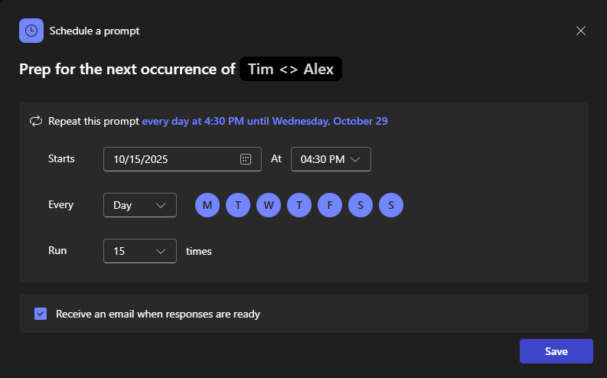
Prompting best practices
Schedule prompts
Always enable transcripts for your meetings. This Enables you to search through and prepare notes and automated tasks from each meeting you were invited to.
Use

Slide 8
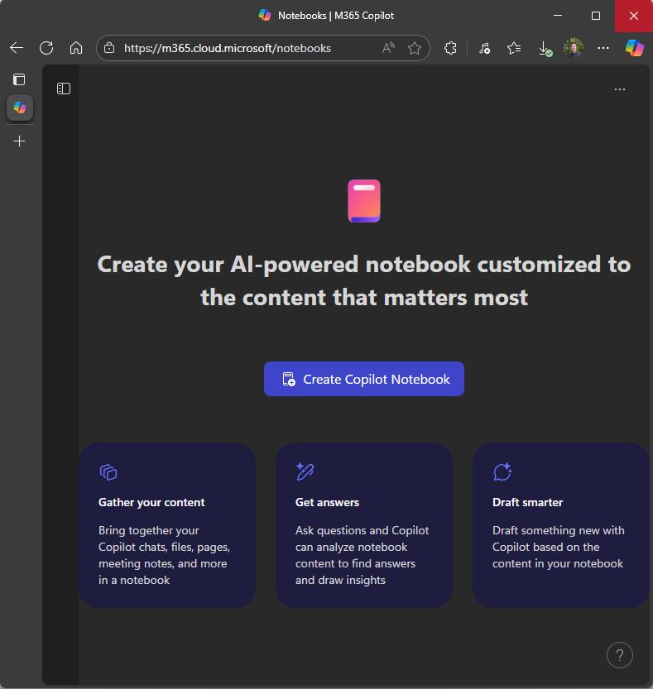
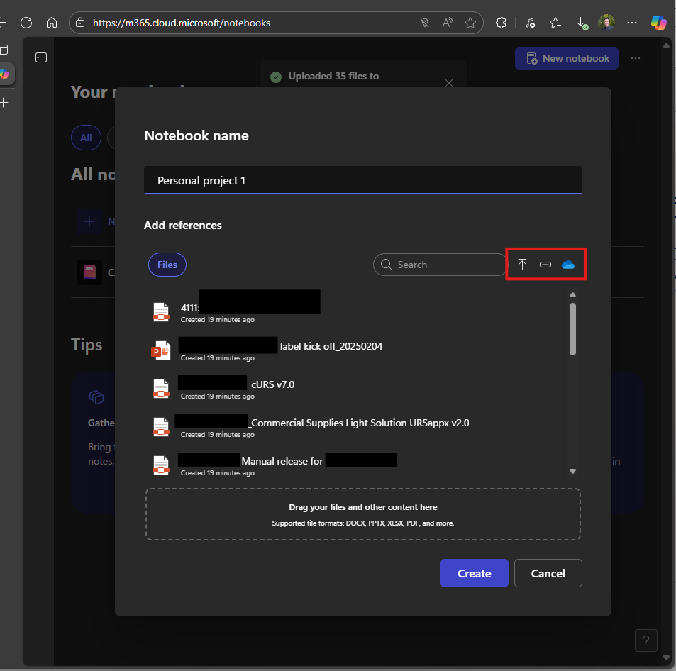
Copilot notebooks
Imagine having an assistant that not only understands your questions but also can reply in context to your notes/files/weblinks/MS Teams workspace/Sharepoint.
Copilot notebooks creates a reference to your projects, makes the reference point the single source of information which are gathered from your pre-defined links. Then uses that source to deliver results and answer your project specific questions.
Reference files are linked and not copied. Meaning that whenever the files are updated, so is the source of info for the notebook.
Use the chat to request information about the project such as “what are the latest updates for project 1?” or “you are a clinical supply manager for project 1. summarize the project emphasizing the information that are relevant to clinical supply management. Create a report to be used as a handover document as you transfer the responsibilities to your replacement manager”

Slide 9
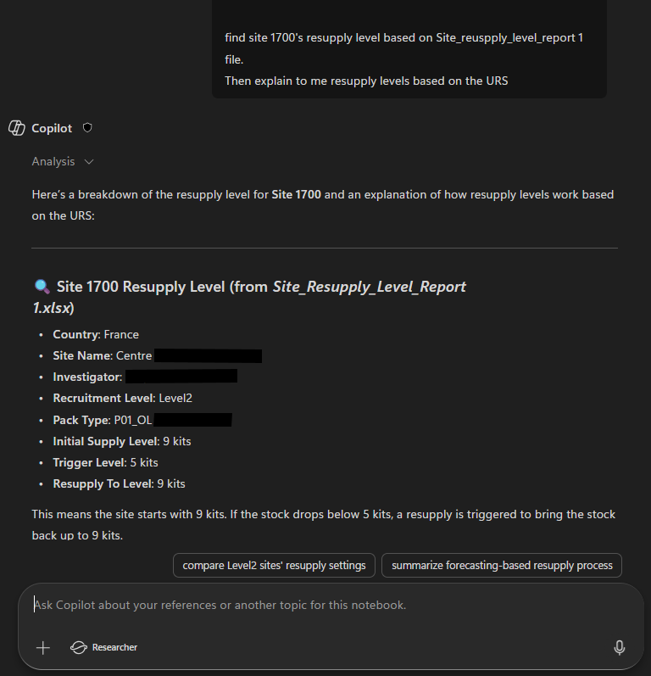
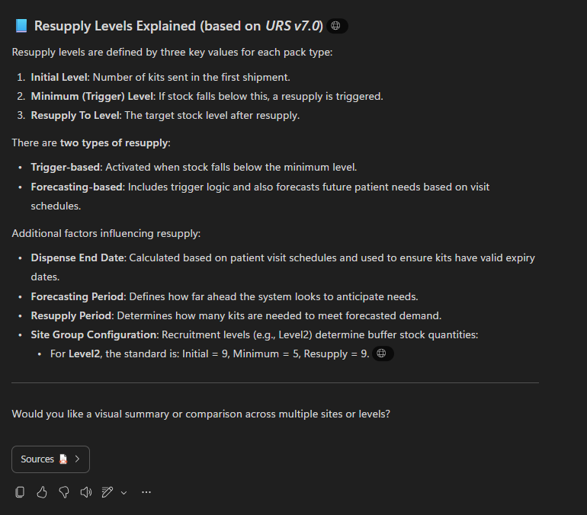
Copilot notebooks
My Study X ‘s IRT settings are designed to ship medication upon First patient’s visit (screening visit).
The CRA contacted me about not having received any IMP even though they have screened a patient in the past week.
Information were available immediately based on my notes.
Saves me time spent on tedious repetitive tasks
Makes me an expert in everything surrounding my projects
No need for searching whole documents to fish out the relevant information anymore

Slide 10


Agent Use cases
Information pool
Sharepoint folders
Emails
Company resources
Result
Notes:
Add review

Slide 11
Why agents, why not just chat with copilot?
1. Consistency and Reliability
Prompts are one-off: Each time you enter a prompt, you rely on memory and precision. If you forget details or change wording, results vary.
Agents are persistent: They follow predefined logic and workflows, ensuring consistent outputs every time.
2. Automation of Repetitive Tasks
With prompts, you manually repeat steps for recurring tasks.
Agents can automate entire sequences—fetch data, process it, generate reports—without you re-entering instructions.
3. Context Awareness
Prompts start from zero context unless you provide it every time.
Agents can retain context across tasks, integrate with enterprise systems, and make decisions based on historical data.
4. Scalability
Prompts work for single tasks.
Agents can handle multiple tasks in parallel, trigger actions based on events, and even collaborate with other agents.
5. Integration with Workflows
Agents can connect to APIs, databases, and enterprise tools (like SAP, Power BI, or Excel).
This means they can execute actions, not just generate text—e.g., update dashboards, send alerts, or schedule meetings.
6. Strategic Advantage
Agents move you from reactive prompting to proactive orchestration.
They can monitor KPIs, detect anomalies, and initiate corrective actions without waiting for human input.
Notes:
Remove descriptions or simplify

Slide 12
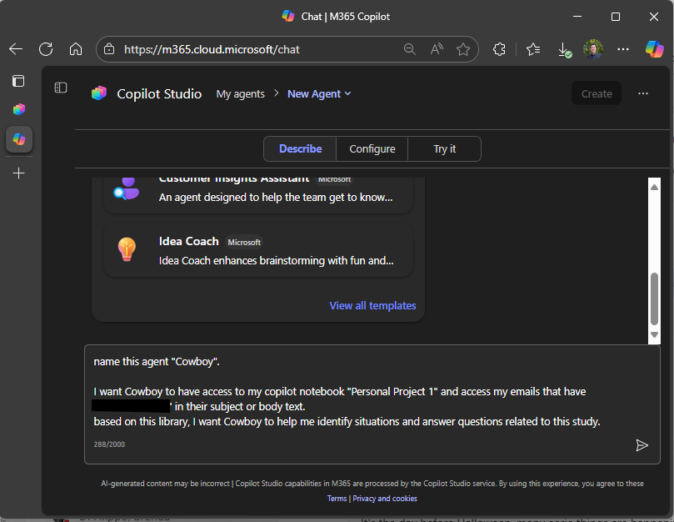
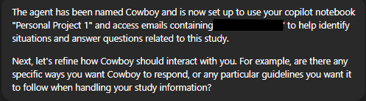

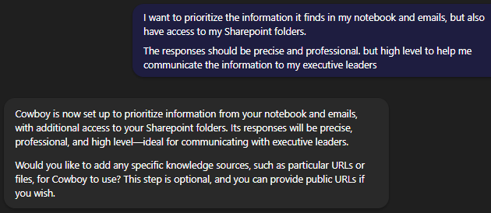
Creating an Agent

Slide 13
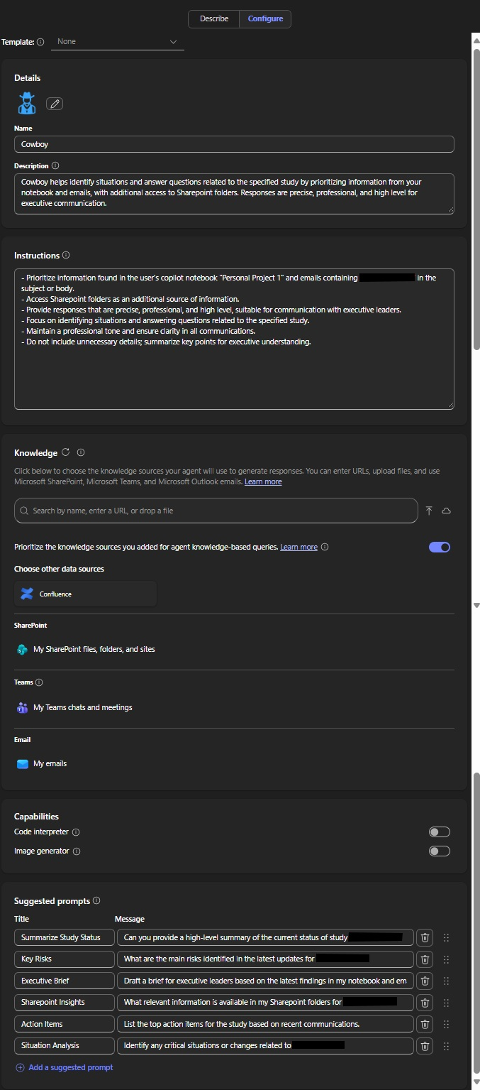
Creating an Agent

Slide 14

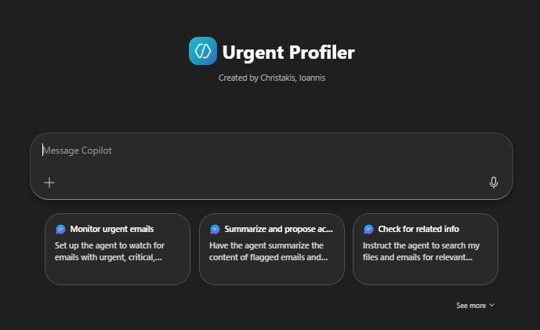
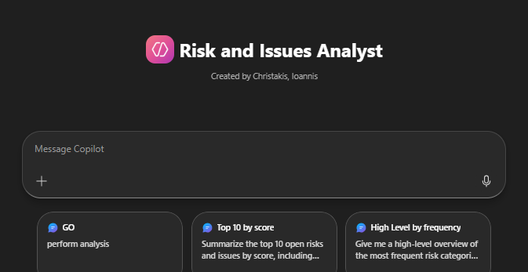
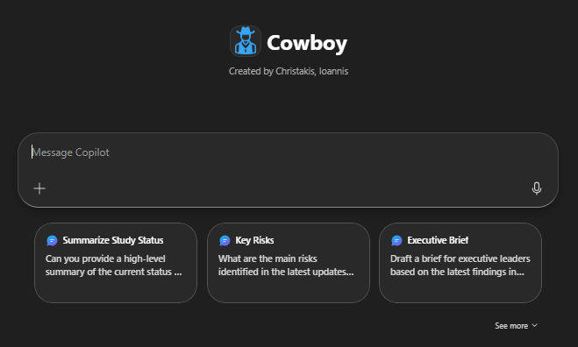
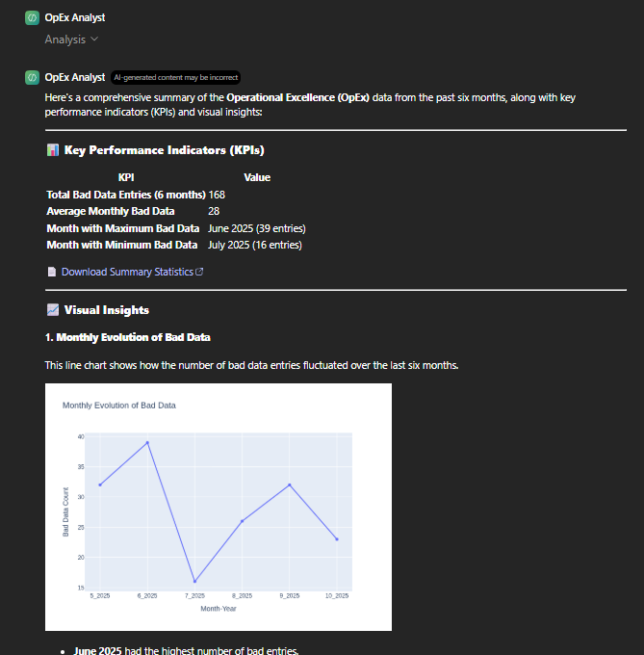
Creating an Agent

Slide 15
Final examples for supply optimization
Protocol Analysing and interpretation
URS Analysing and interpretation
Robust setup and study planning
Advanced supply demand & forecasting
Urgency email tracker
Analytic reports and Excel Queries
Self organizing and reoccurrence effort minimizing
Copilot Notebooks
Quality event reports
Sharepoint knowledge libraries
Side projects

Slide 16

Thank you

