Slide 1


Shifting Dynamics in the Global Supply Chains
Notes:
Welcome and set the stage. Introduce ECPA and the purpose of this session.

Slide 2
Agenda
Some Introductions
Some Challenges
Some Perspective
Changing Landscapes
Changing Roles

Slide 3
1) Some Introductions

Slide 4

Introductions
Ton Knipscheer – Matchmaker in Packaging
    Experienced Packaging Consultant
    Executive Director & Board Member at ECPA
    Juror at NL Packaging Awards
    Consultant at ThePackHub
Notes:
Explain how macro factors like inflation, tech disruption, and regulation are driving supply chain shifts.

Slide 5
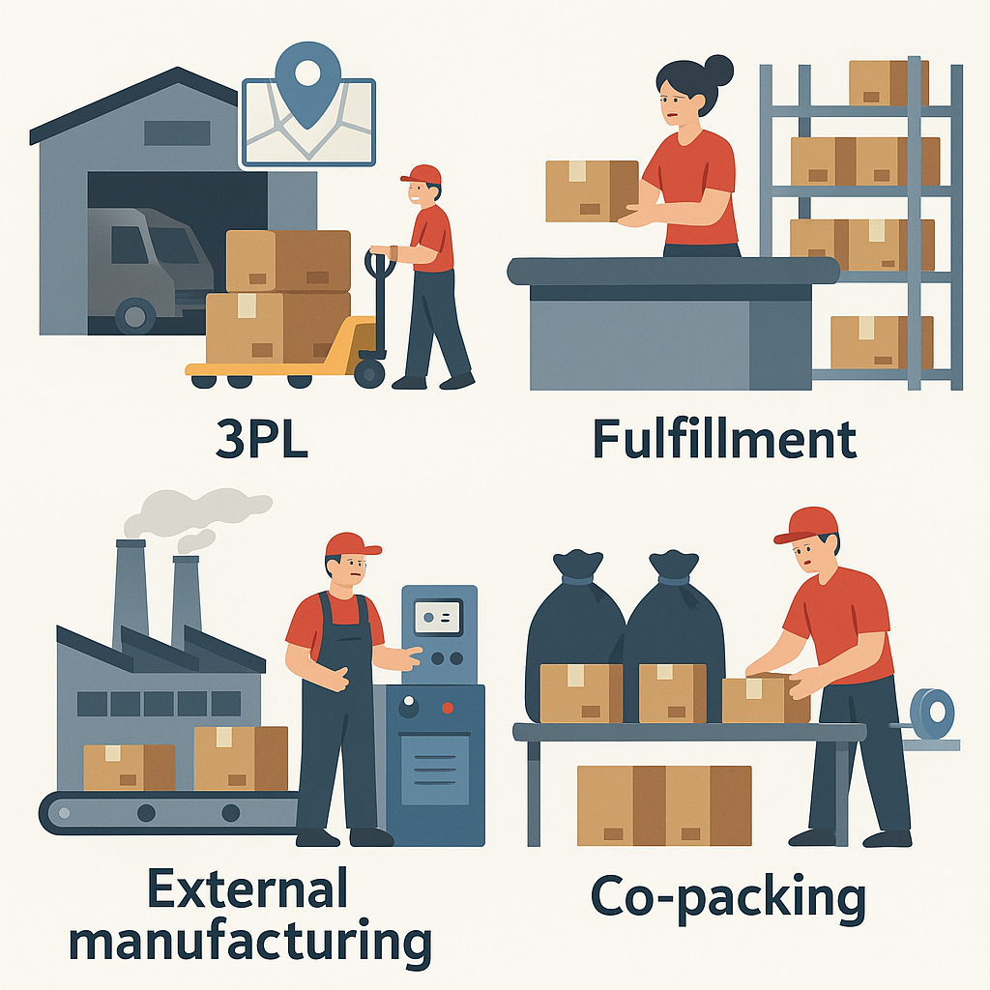
Contract Packing / Contract Manufacturing
A matter of definition:
CMO/CMDO
External Manufacturing
Outsourcing
Private Label
Notes:
Clarify CP/CM and the expanding role of external production models in global manufacturing.

Slide 6
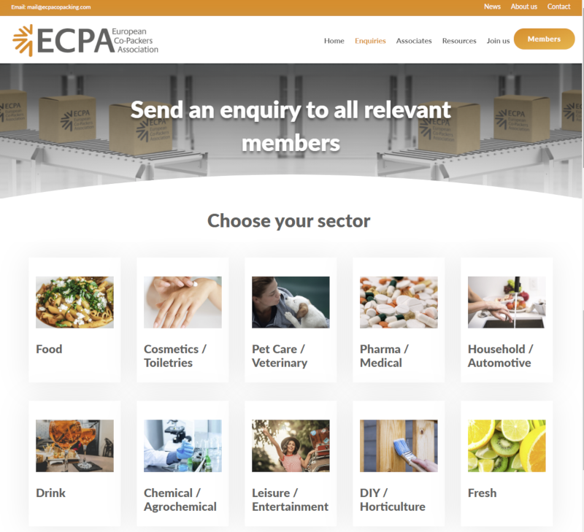

Introductions
Active in all product categories
Confectionery

Slide 7
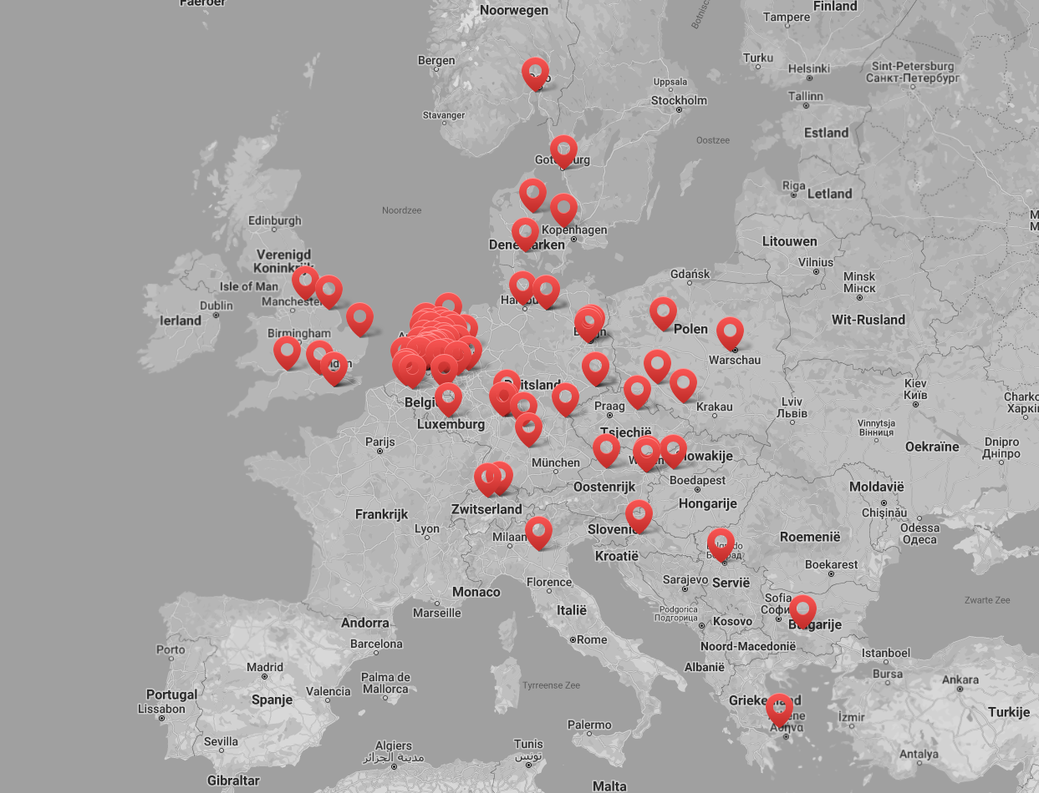

Introductions
100 members across Europe
Notes:
Welcome and set the stage. Introduce ECPA and the purpose of this session.

Slide 8
2) Some Challenges

Slide 9

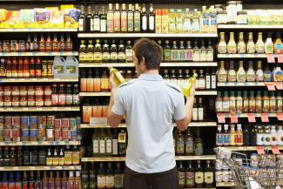
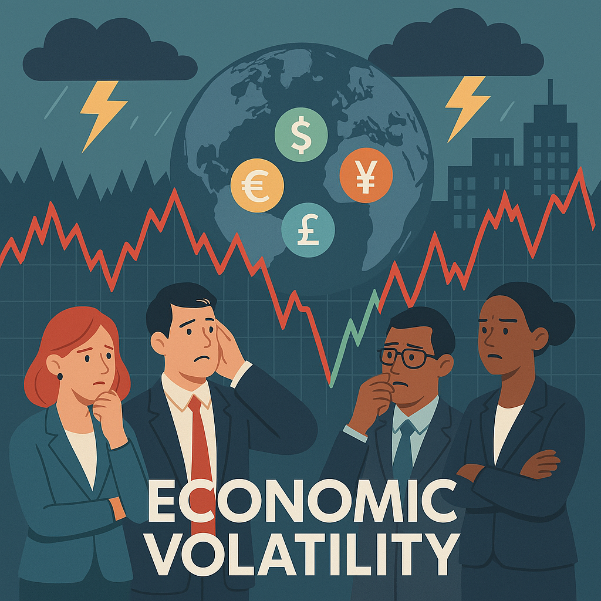

The global supply chain is rapidly evolving
Technological accelaration
Changing consumer behaviour
Economic disruption
Regulatory pressure
Notes:
Explain how macro factors like inflation, tech disruption, and regulation are driving supply chain shifts.

Slide 10
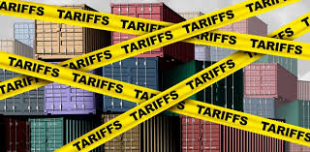
The Perfect Storm – Part 1
• Rising costs: labour, energy, materials
• Skilled labour shortages
• Increasing legislation
• Freight and transport constraints
Tariffs
Notes:
Discuss rising costs, labor shortages, and the regulatory landscape reshaping operational models.

Slide 11

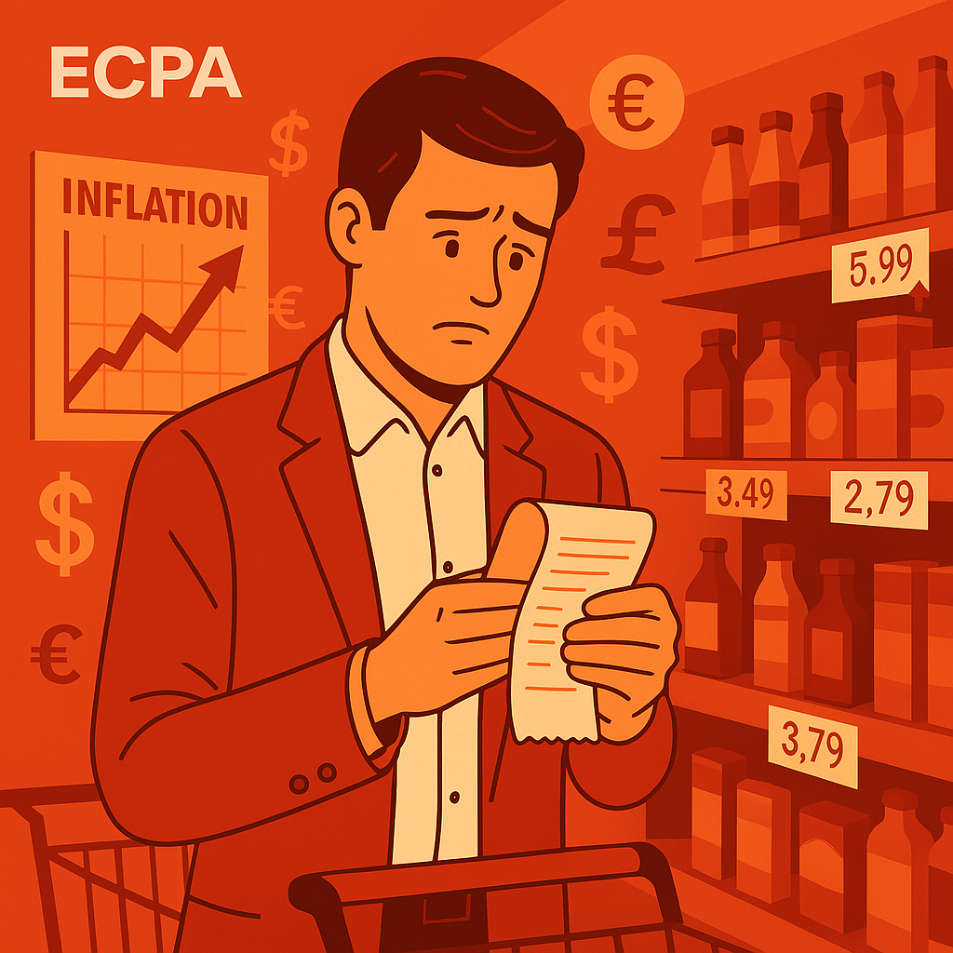
The Perfect Storm – Part 2
• Inflation
• Geopolitical instability
• Fragmented global production and sourcing
• Consumer Say-Do-Gap
Notes:
Add how geopolitics, sourcing instability, and post-pandemic realignment drive change.

Slide 12

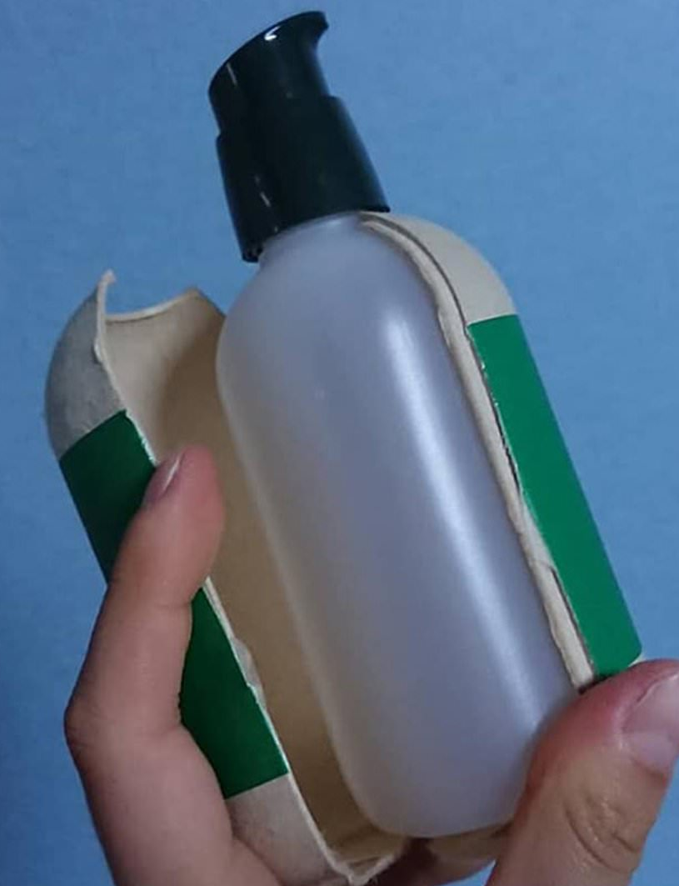
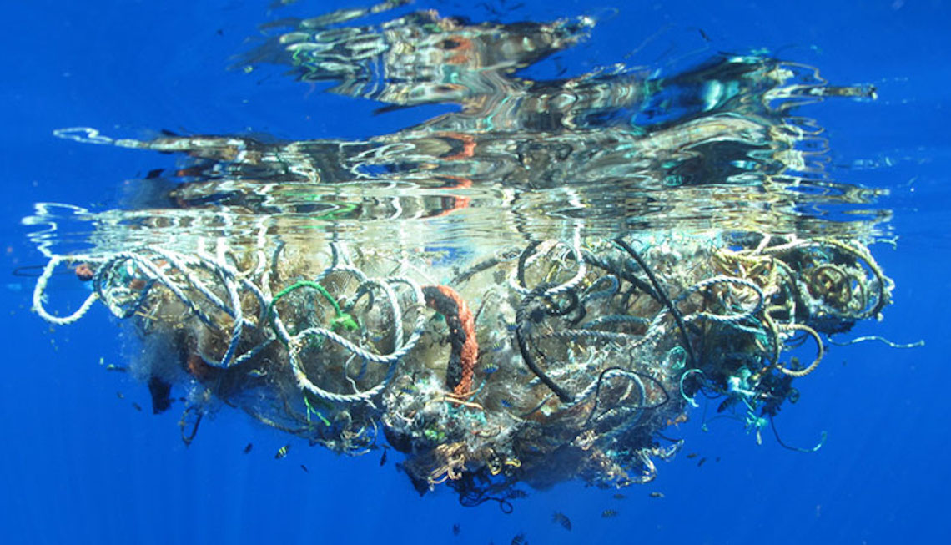
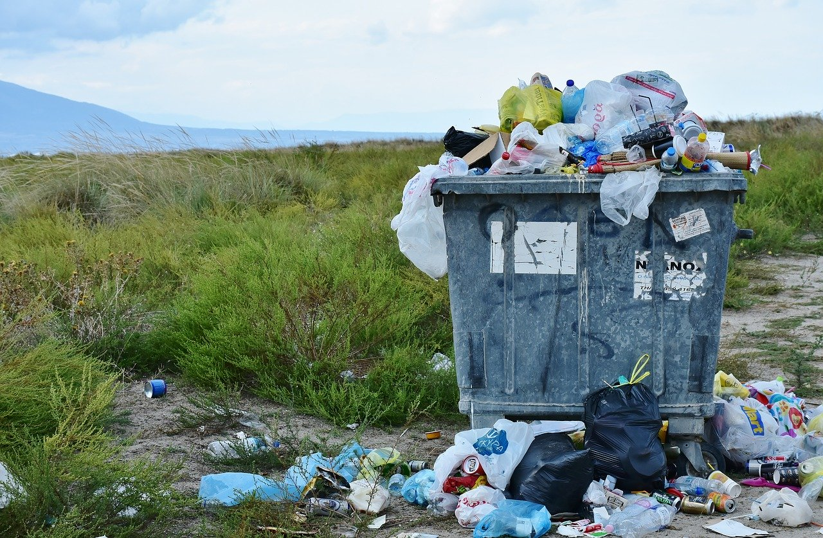
Serious Sustainability Challenges
• Not simple lightweighting, 'paperization’ or Greenwashing
• Unrealistical shelf life
• Design-for-recycling + clear consumer info on recycling
• Eco-Modulation
• Emotions vs Facts (NGO’s)
55% of Ocean Plastic is Fishery Related!
Notes:
Address packaging sustainability misconceptions and explain 2024 policy incentives.

Slide 13
3) Some Perspective

Slide 14
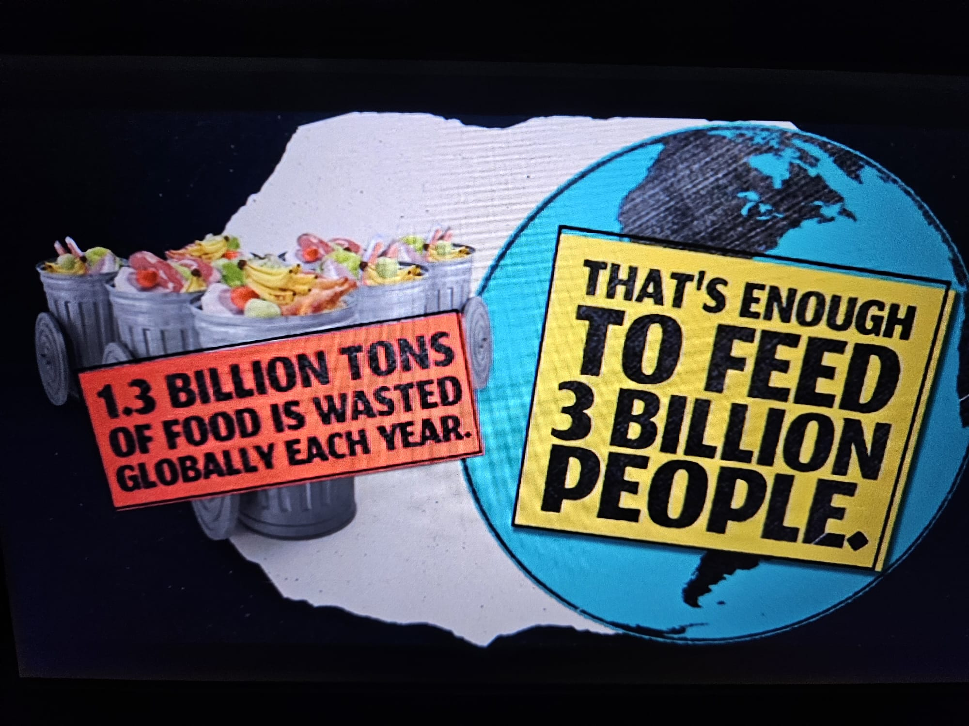
Let’s put things into perspective
Fit-for-Purpose Packaging = realistical shelf life
Food Safety – 30% of food still gets wasted

Slide 15
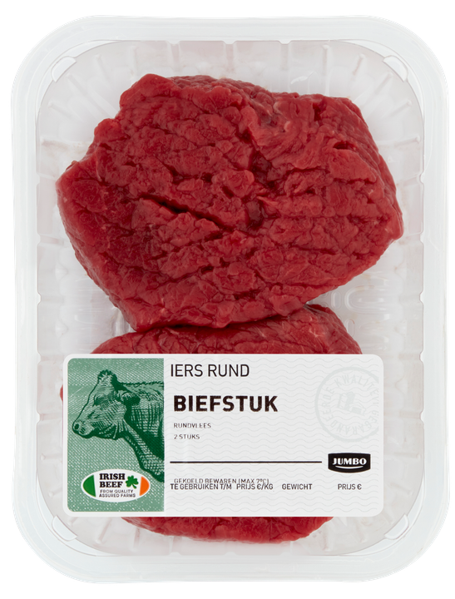
What do you think has the highest impact?
CO2 Footprint:
Meat 98%
Packaging 2%

Slide 16
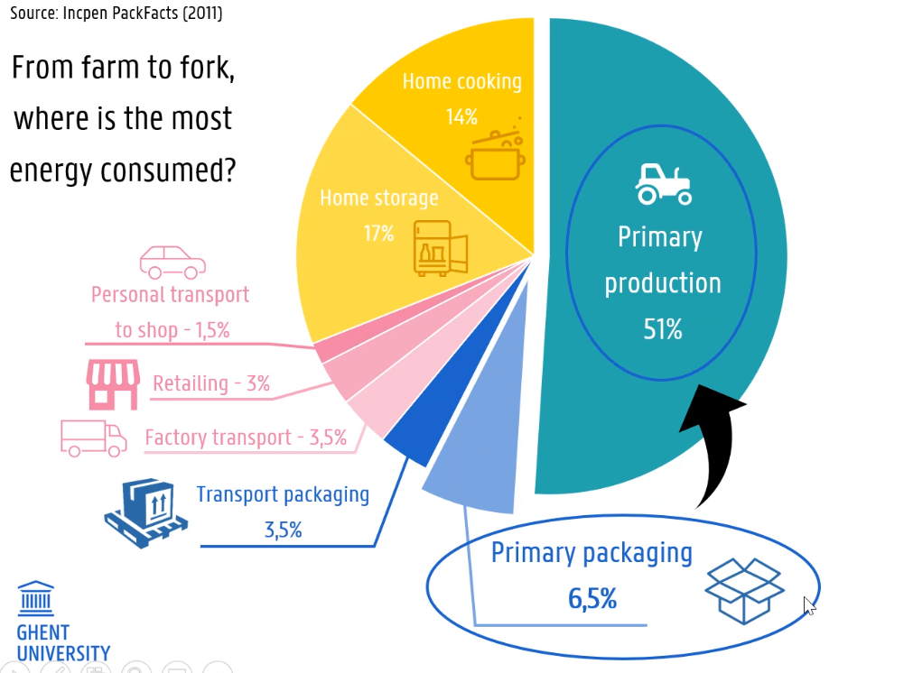
Packaging protects more than it consumes!

Slide 17
4) Changing Landscapes

Slide 18


Change is the only constant,
but we’re talking serious changes!
Here’s just some examples:
GenNext trust influencers and algorithms over brand owners!
GenNext want it now, the same day
GenNext are redefining brand loyalty. They expect brands to earn it!

Slide 19
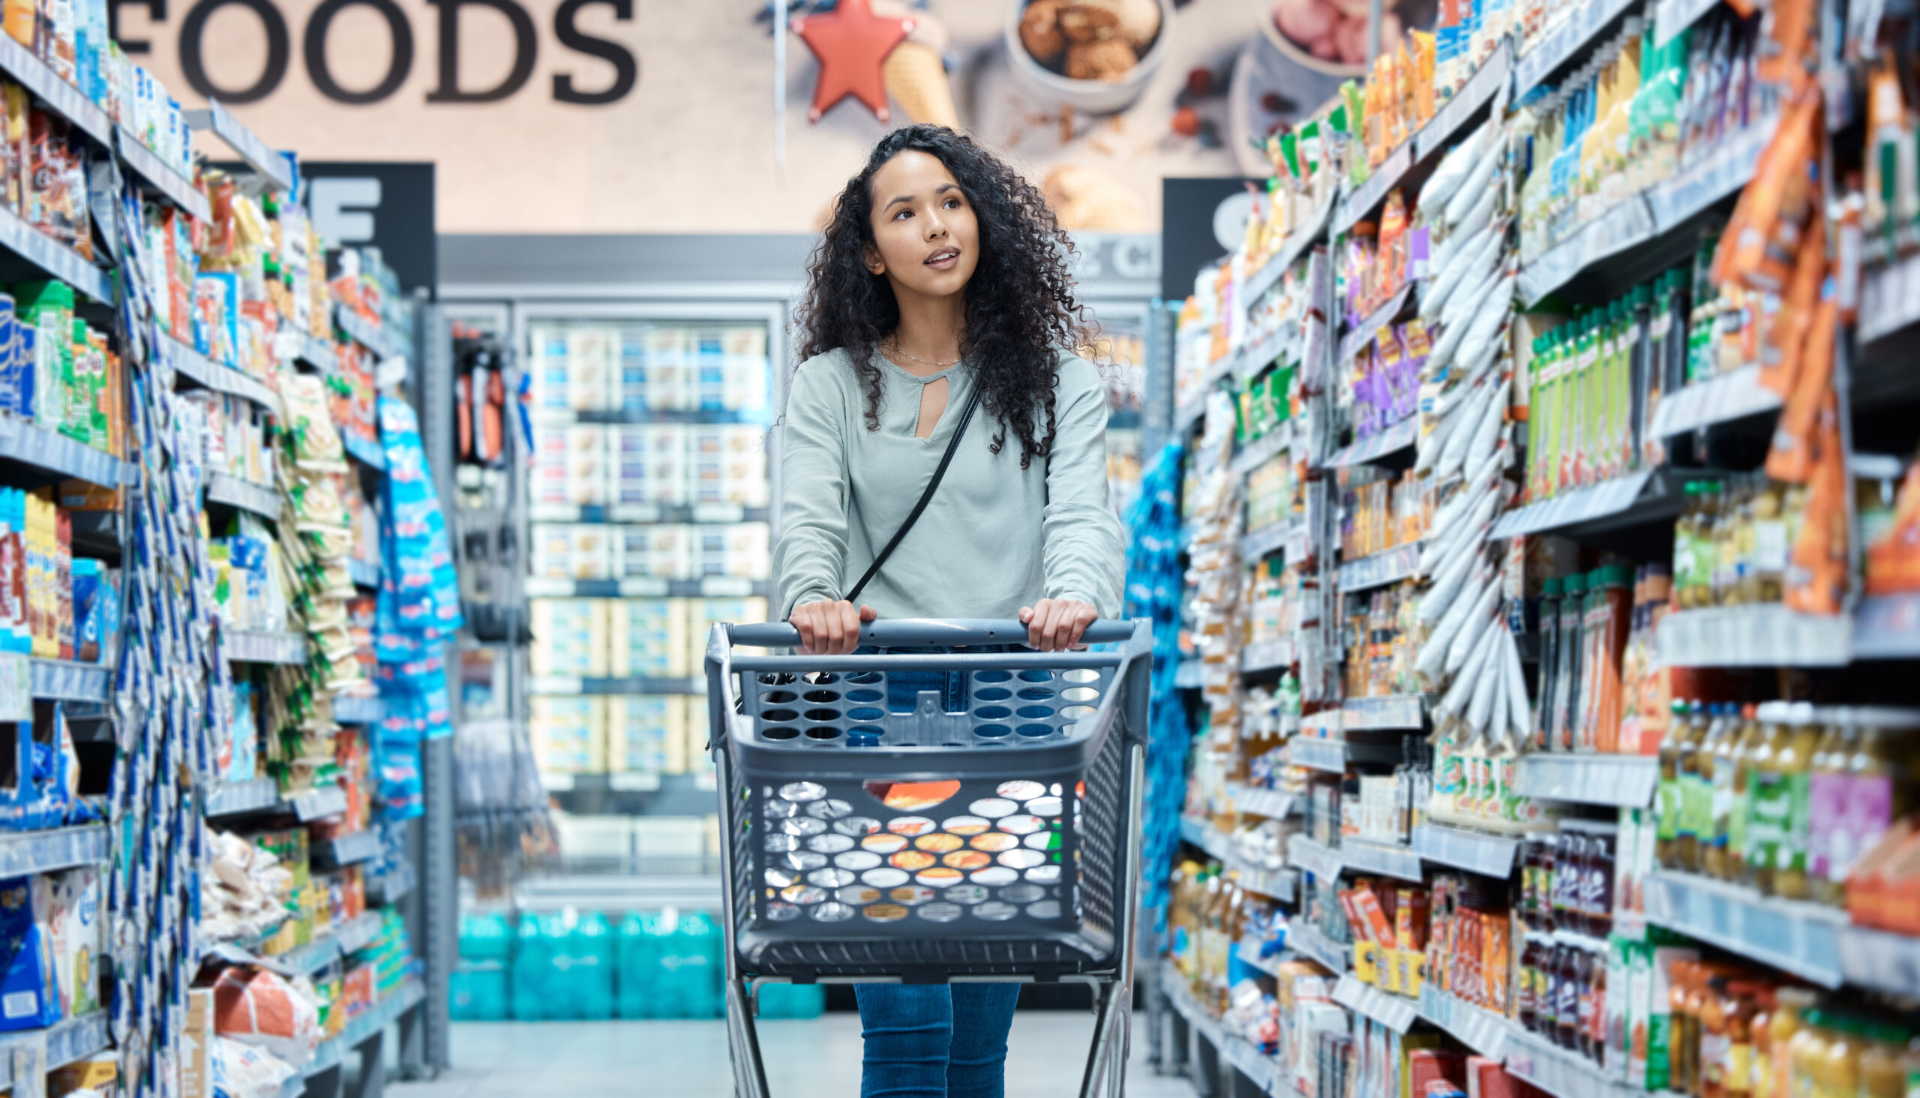

Changing Landscapes
• Time-to-Market
• More SKU’s
• Shorter lifecycles
• Personalization, premiumization
• Capex
Notes:
Show how GenNext is reshaping demand: instant, digital-first, personalized.

Slide 20
5) Changing Roles

Slide 21
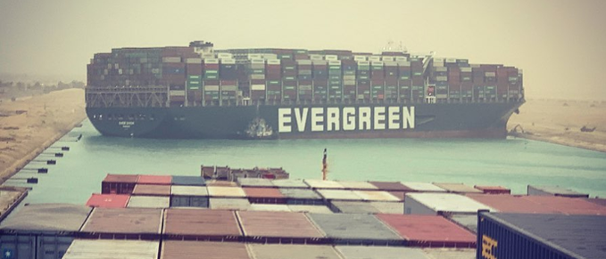
Changing Roles in the Supply Chain
Brand owners focus on brands
Co-packers lead execution and innovation
Nearshoring & Reshoring the fragmented supply chain
Notes:
Talk about why brand owners need agile, certified partners like co-packers.

Slide 22

Is this part of Brand Owners DNA?
No, and here’s why:
Speed to Market!
Growing number of SKU’s
Shorter life cycles
& CAPEX!

Slide 23


Slide 24
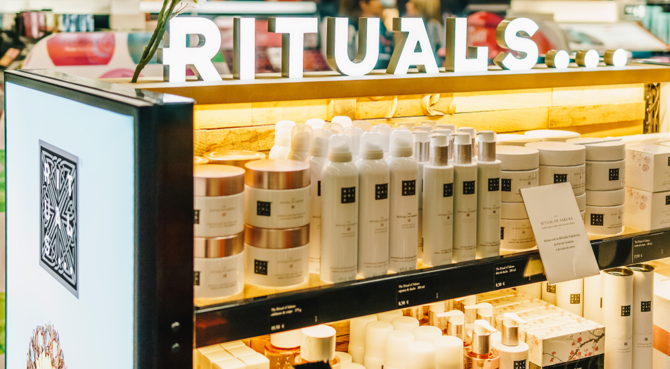
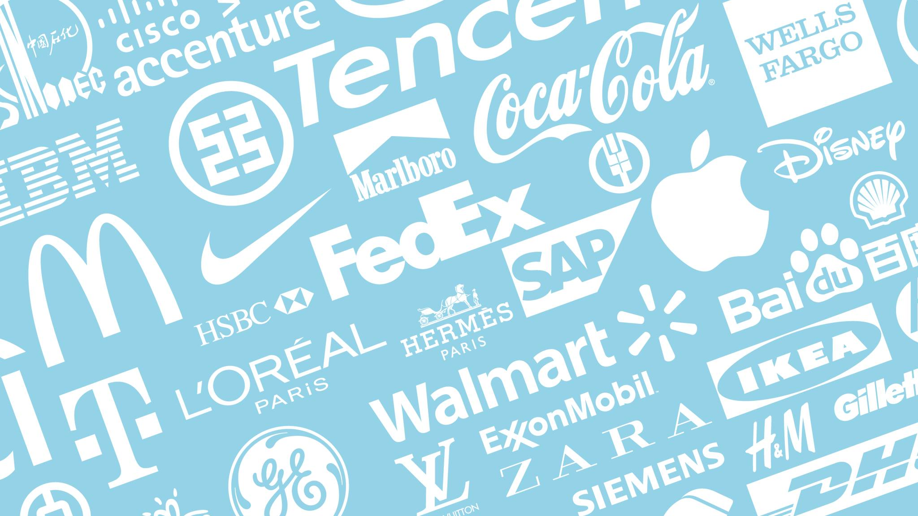
Brand Owners build Brands
That’s what they do best!

Slide 25

Contract Packing/Manufacturing Market outlook:
$100B (2023) → $160B (2028)
CAGR: >10%
Notes:
Support with growth forecasts and emphasize the importance of flexibility and local capacity.

Slide 26

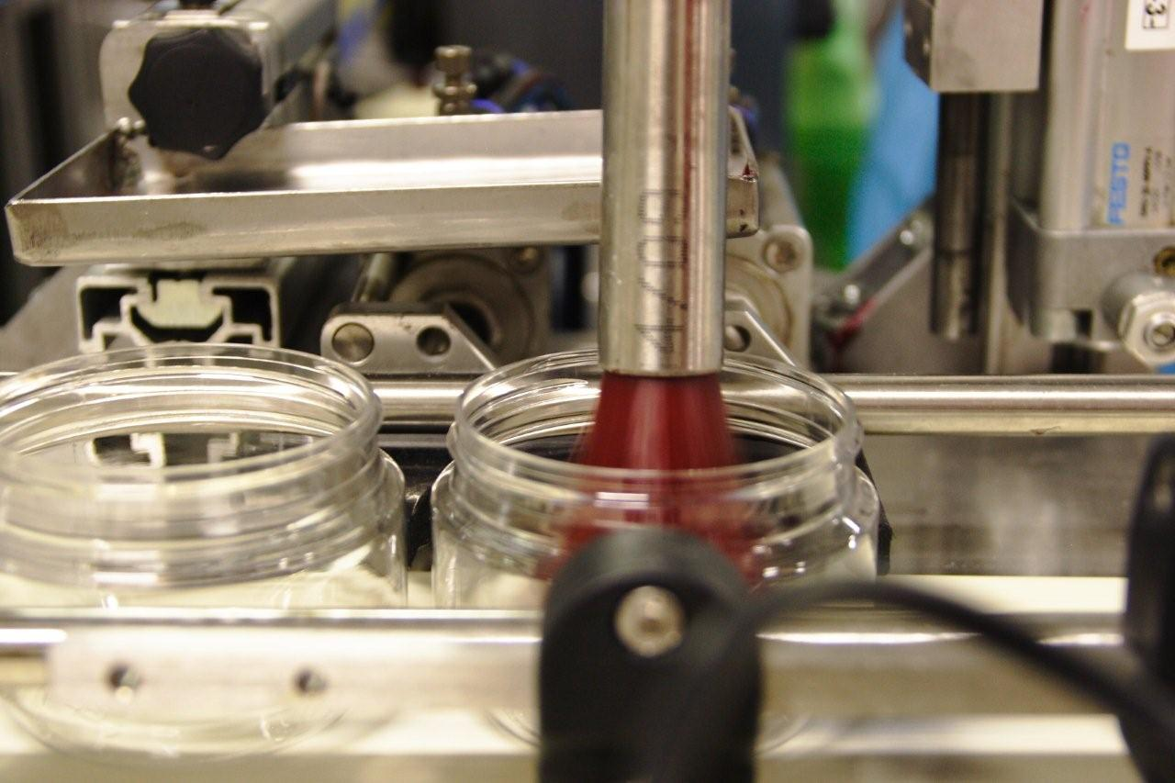
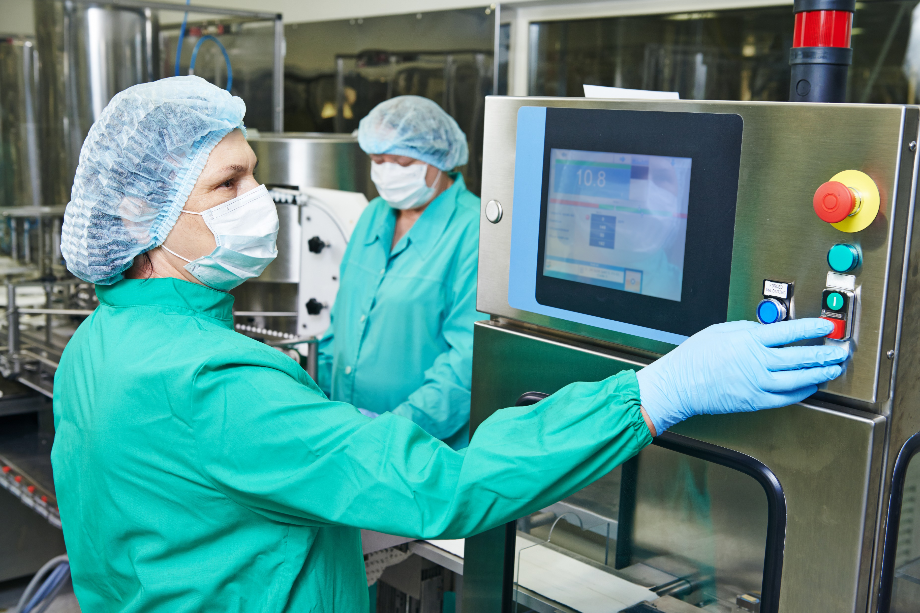
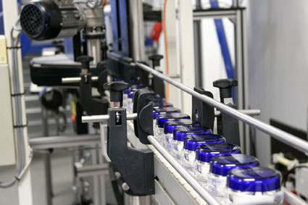
Success Factors & Market Outlook
Key Factors:
Scalability
Machine availability
Certifications
Notes:
Support with growth forecasts and emphasize the importance of flexibility and local capacity.

Slide 27
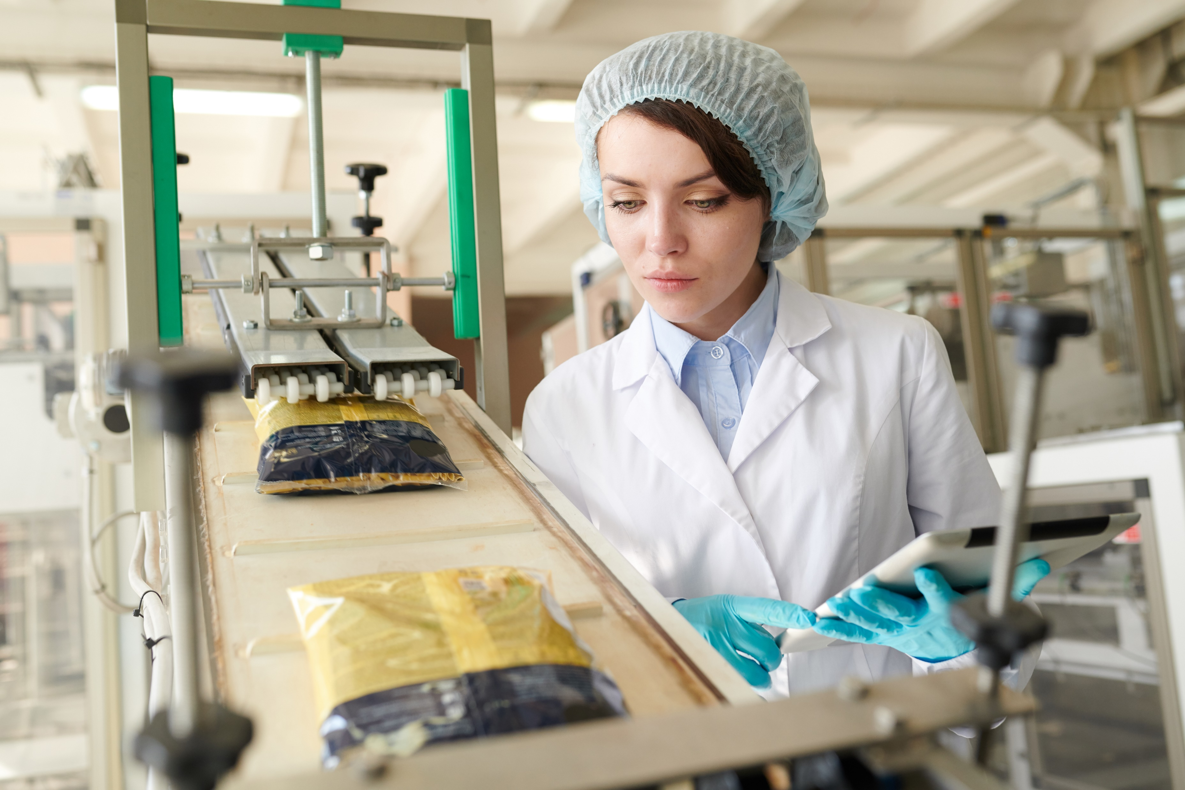
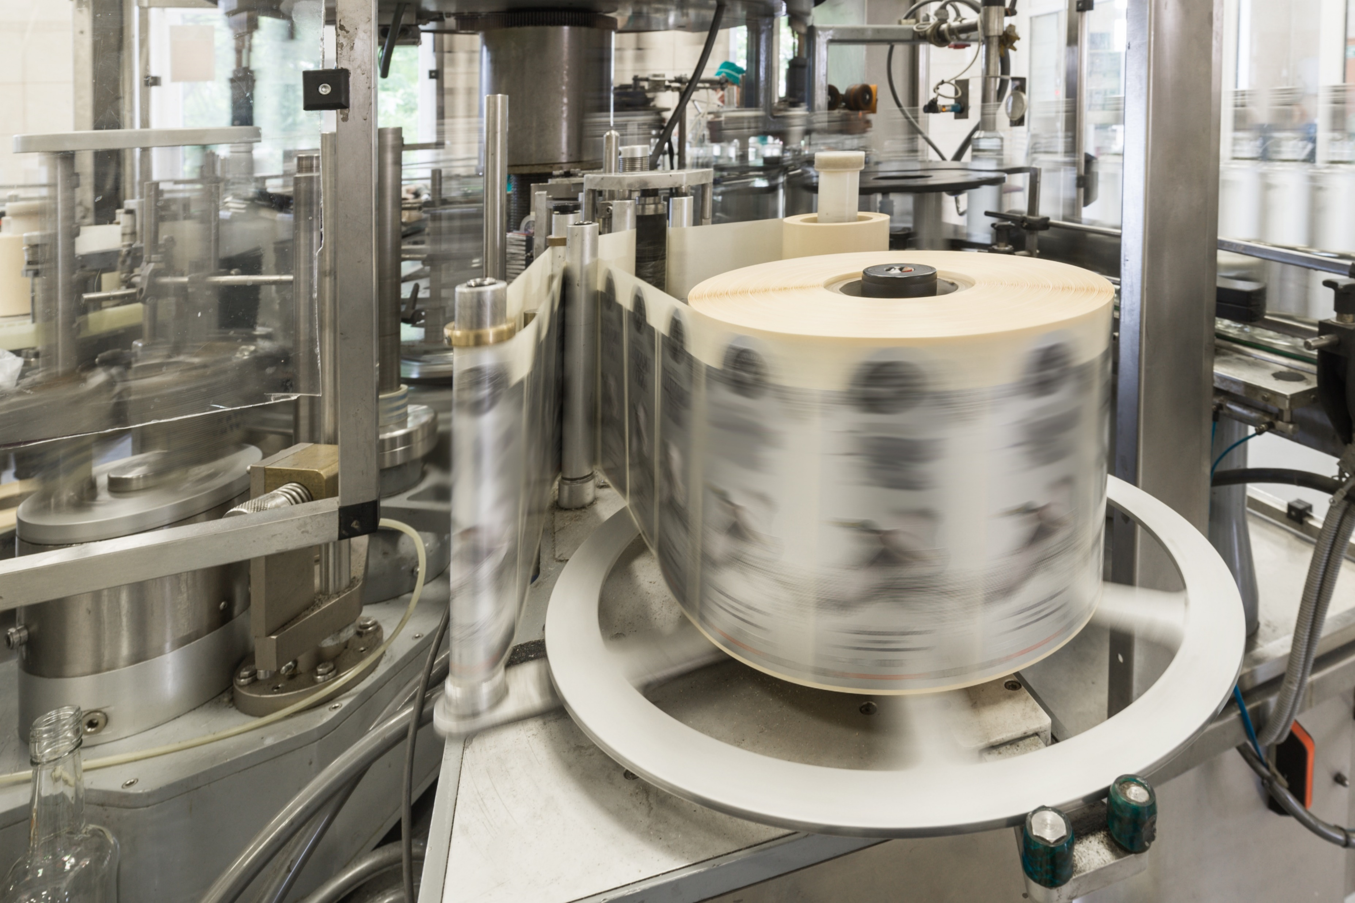
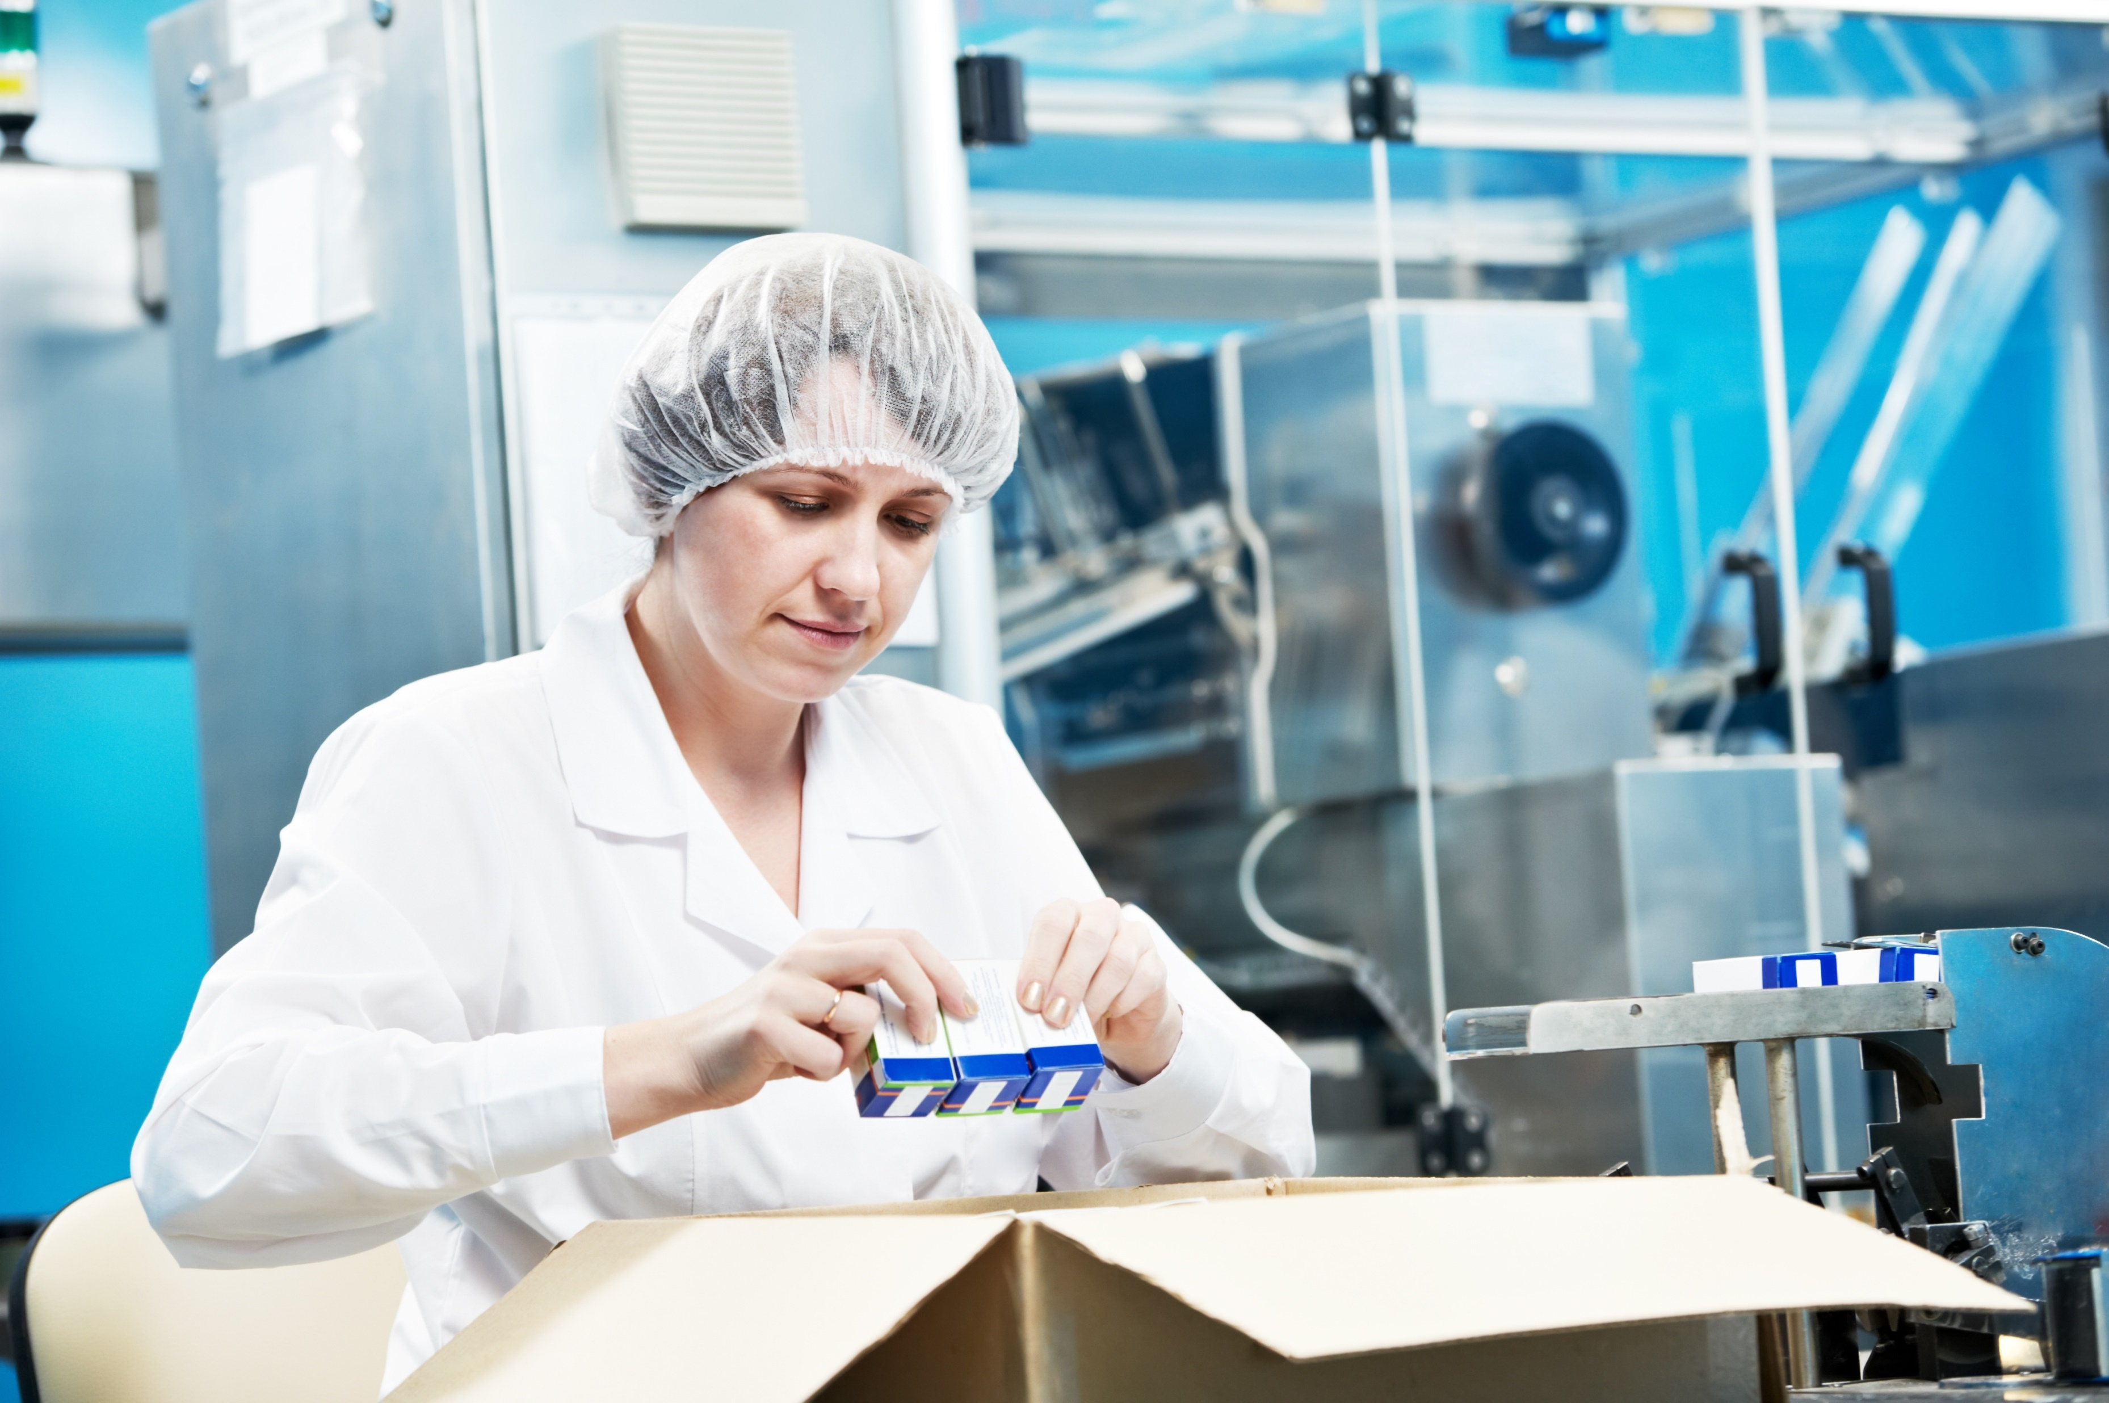
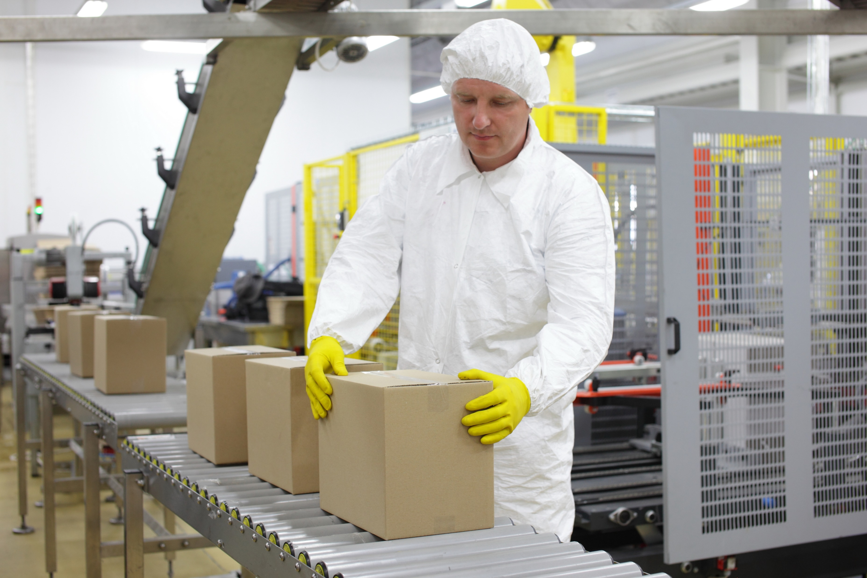
Success Factors & Market Outlook
Key Factors:
Agility
Flexibility
Early Engagement
Notes:
Support with growth forecasts and emphasize the importance of flexibility and local capacity.

Slide 28
Conclusion
Brand owners thrive by building brands while partners master operations!
Notes:
Wrap up: dynamic supply chains require new collaboration and adaptive models.

Slide 29
Thank you!
Notes:
Open for questions, recap key themes, and invite discussion.

