Slide 1
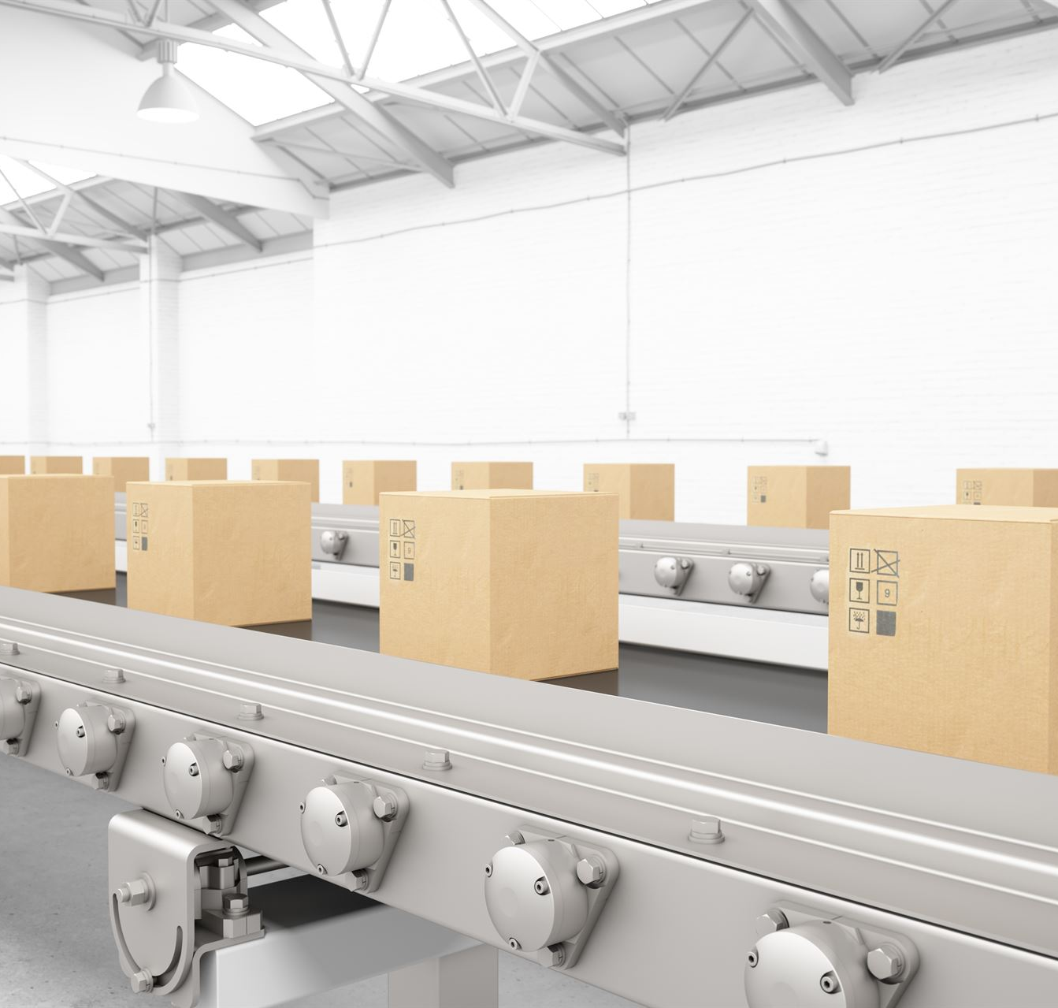
Paid to Deliver – The Future of Pharma Logistics
Innovations driving efficient pharmaceutical supply chains
Notes:
---

Slide 2
Logistics – How are you getting there?
Notes:
---
This slide references information from the following file: https://iclgroup365-my.sharepoint.com/personal/bruce_holden_icl-group_com/_layouts/15/Doc.aspx?sourcedoc=%7B1EDCB2E4-37AB-4F58-949A-48E4936CD834%7D&file=paid%20to%20deliver.docx&action=default&mobileredirect=true
Should Your Logistics Department Be In-House or Use a 3PL, Overview of Incoterms and Discussion

Slide 3

Paid to Deliver – The Future of Pharma Logistics
Critical Role of Logistics
  Pharma logistics ensures timely, safe, and compliant delivery of medicines impacting patient outcomes and supply chain resilience.
Technological Innovations
  Future pharma logistics relies on cold chain management, AI/ integration measures, IoT, and meeting sustainability requirements.
Industry Challenges
  Complex customs, rising transport costs, quality assurance, and geopolitical issues create uncertainty in pharma logistics.
Strategic Adaptation
  Companies must adopt sustainability, tracking and traceability, and strategies to optimize processes and service delivery.
Notes:
---
This slide references information from the following file: https://iclgroup365-my.sharepoint.com/personal/bruce_holden_icl-group_com/_layouts/15/Doc.aspx?sourcedoc=%7B1EDCB2E4-37AB-4F58-949A-48E4936CD834%7D&file=paid%20to%20deliver.docx&action=default&mobileredirect=true
Pharmaceutical logistics is undergoing a transformative phase driven by globalization, technological advancements, and evolving regulatory frameworks. The concept of 'Paid to Deliver' emphasizes the critical role logistics plays in ensuring timely, safe, and compliant delivery of medicines and healthcare products. This introduction sets the stage for understanding how logistics impacts patient outcomes, cost efficiency, and supply chain resilience. The future of pharma logistics will be shaped by innovations in cold chain management, sustainability practices, and digital technologies such as AI and IoT. Companies must adapt to these changes to remain competitive and compliant. The industry faces challenges such as increasing complexity in customs regulations, rising transportation costs, and the need for robust quality assurance. Additionally, geopolitical factors and trade wars add layers of uncertainty, making strategic planning essential. This presentation explores key aspects of pharma logistics, including transport modes, challenges, incoterms, customs, cold chain maintenance, sustainability, AI integration, tracking systems, and future trends. By understanding these elements, stakeholders can make informed decisions to optimize operations and enhance service delivery.

Slide 4

How do you want to go?
Container Shipping
  Container shipping is cost-effective for large volumes but needs strict temperature control and longer delivery times. –conditioned cooling?
Bulk Transport
  Bulk transport suits raw materials but involves contamination risks and complex handling requirements. Very cost effective
Truck Transport
  Truck transport offers flexibility and faster regional delivery but faces driver shortages
  Air Transport
  Air transport is fastest for high-value or time-sensitive goods but costly and limited by capacity constraints.
Notes:
---
This slide references information from the following file: https://iclgroup365-my.sharepoint.com/personal/bruce_holden_icl-group_com/_layouts/15/Doc.aspx?sourcedoc=%7B1EDCB2E4-37AB-4F58-949A-48E4936CD834%7D&file=paid%20to%20deliver.docx&action=default&mobileredirect=true
Pharma logistics relies on multiple transport modes, each offering distinct advantages and challenges. Container shipping is cost-effective for large volumes but requires stringent temperature control and longer lead times. Bulk transport is suitable for raw materials but poses risks related to contamination and handling. Truck transport provides flexibility and faster delivery for regional distribution, yet faces challenges such as driver shortages and regulatory compliance. Air transport is the fastest option, ideal for high-value or time-sensitive shipments, but it is expensive and subject to capacity constraints. Each mode demands specialized handling to maintain product integrity, especially for temperature-sensitive goods. Companies must weigh factors like cost, speed, reliability, and regulatory requirements when selecting transport options. Additionally, multimodal strategies are increasingly common, combining different modes to optimize efficiency and mitigate risks. Understanding these dynamics helps logistics managers design resilient supply chains that meet both business and patient needs.

Slide 5
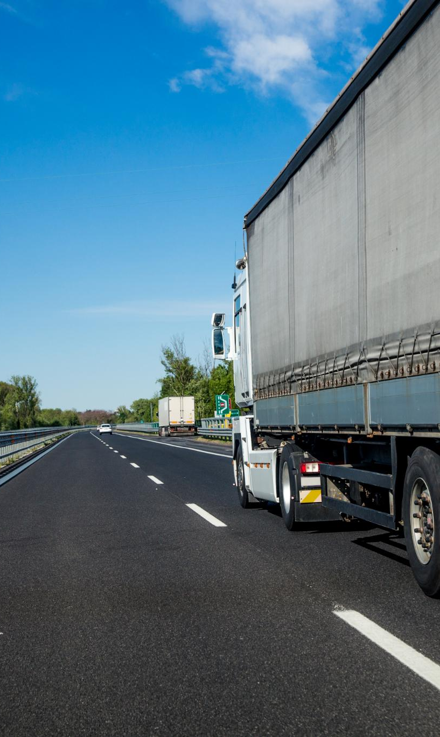
You are “challenging”
Rising Transportation Costs
  Fuel price uncertainty and driver labour shortages create unstable transportation costs, putting pressure on logistics budgets and forecasting.
Complex Supply Chain Control
  Managing control over multi-layered supply chains is challenging, especially with third-party outsourcing involved.
Regulatory Compliance and Customs
  Varying customs regulations and strict quality audits increase delays and administrative workload.
Risk Management and Technology
  Effective risk strategies and real-time technology investments are key to mitigating disruptions.
Notes:
---
This slide references information from the following file: https://iclgroup365-my.sharepoint.com/personal/bruce_holden_icl-group_com/_layouts/15/Doc.aspx?sourcedoc=%7B1EDCB2E4-37AB-4F58-949A-48E4936CD834%7D&file=paid%20to%20deliver.docx&action=default&mobileredirect=true
Pharma logistics faces numerous challenges that impact cost, control, and compliance. Rising transportation costs, driven by fuel prices and labor shortages, strain budgets. Maintaining control over complex supply chains is difficult, especially when outsourcing to third-party providers. Customs regulations vary by country, creating delays and increasing administrative burdens. Quality assurance and audit requirements demand rigorous documentation and monitoring to prevent product degradation or regulatory violations. These challenges necessitate robust risk management strategies, investment in technology for real-time visibility, and strong partnerships with reliable logistics providers. Companies must also navigate geopolitical uncertainties, trade restrictions, and evolving legislation, which can disrupt supply chains unexpectedly. Addressing these issues requires a proactive approach, combining operational efficiency with strategic foresight.

Slide 6

Long term contracts
  Predicable
  Stable
  Great for forecasting and monitoring of
  Costs
  Maintain relationships

Slide 7

A lesson from Chinese philosophy
https://languagelog.ldc.upenn.edu/nll/?p=47078
你的锅" ("it's your pot"/ "it's for you to get the blame”)

Slide 8
Logistics Models and Incoterms
Notes:
---
This slide references information from the following file: https://iclgroup365-my.sharepoint.com/personal/bruce_holden_icl-group_com/_layouts/15/Doc.aspx?sourcedoc=%7B1EDCB2E4-37AB-4F58-949A-48E4936CD834%7D&file=paid%20to%20deliver.docx&action=default&mobileredirect=true
Should Your Logistics Department Be In-House or Use a 3PL, Overview of Incoterms and Discussion

Slide 9
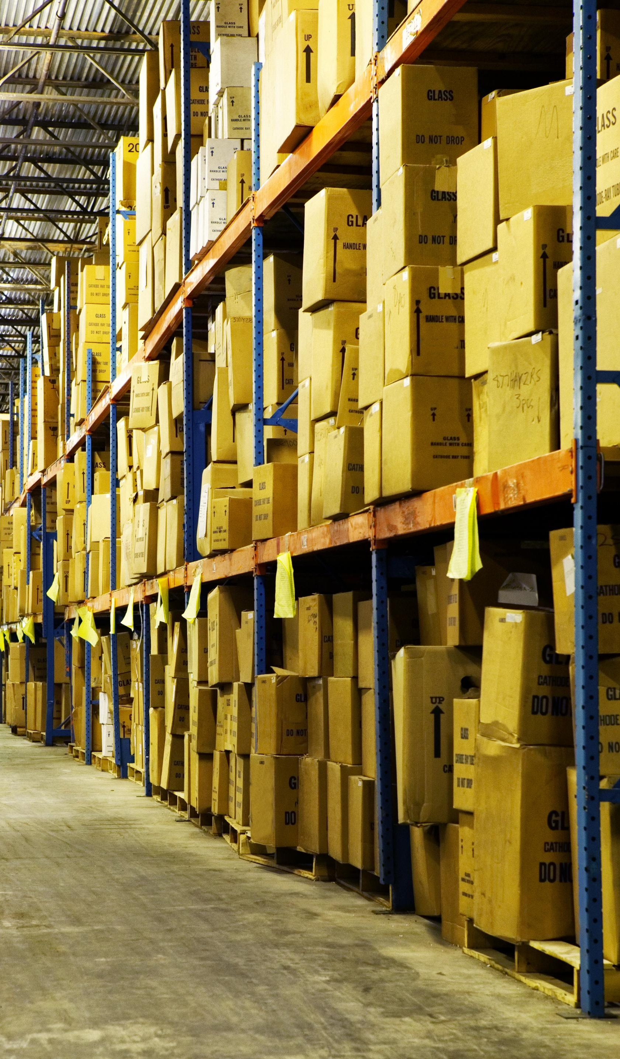
Should Your Logistics Department Be In-House or Use a 3PL
In-House Logistics Benefits
  In-house logistics offers greater control, direct oversight, and better alignment with company culture but requires major investments.
Advantages of 3PL Providers
  3PLs provide expertise, scalability, advanced technology access, and flexibility without heavy capital investment.
Challenges of Outsourcing
  Outsourcing may reduce control and create dependency on external partners, affecting operational autonomy.
Hybrid Logistics Approach
  Combining in-house oversight with selective outsourcing balances control and operational efficiency effectively.
Notes:
---
This slide references information from the following file: https://iclgroup365-my.sharepoint.com/personal/bruce_holden_icl-group_com/_layouts/15/Doc.aspx?sourcedoc=%7B1EDCB2E4-37AB-4F58-949A-48E4936CD834%7D&file=paid%20to%20deliver.docx&action=default&mobileredirect=true
Deciding between an in-house logistics department and outsourcing to a third-party logistics provider (3PL) is a critical strategic choice. In-house logistics offers greater control, direct oversight, and alignment with company culture, but it requires significant investment in infrastructure, technology, and skilled personnel. Conversely, 3PLs provide expertise, scalability, and access to advanced systems without the need for heavy capital expenditure. They can manage complex international operations and offer flexibility during demand fluctuations. However, outsourcing may lead to reduced control and dependency on external partners. Companies must evaluate factors such as cost, operational complexity, regulatory compliance, and long-term strategic goals to determine the best model. Hybrid approaches, combining in-house oversight with selective outsourcing, are increasingly popular for balancing control and efficiency.

Slide 10
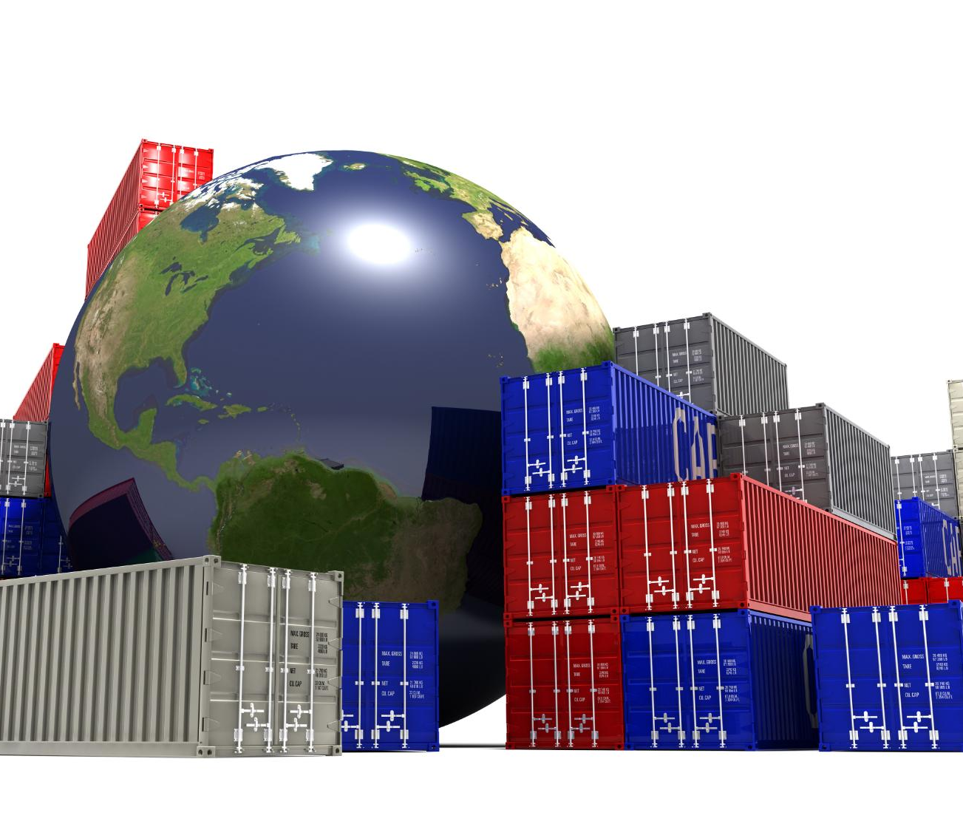
Overview of Incoterms and Discussion
Role of Incoterms
  Incoterms define buyer and seller responsibilities, affecting customs, risk, and cost allocation in global trade.
Common Incoterms Examples
  Terms like CFR, CIF, and FOB specify who covers transportation and insurance expenses in shipments.
Importance in Pharma Logistics
  Proper Incoterm selection ensures compliance and minimizes delays in pharmaceutical supply chains.
Adapting to Trade Changes
  Businesses must review Incoterms regularly to adjust to evolving trade policies and optimize shipping control.
Notes:
---
This slide references information from the following file: https://iclgroup365-my.sharepoint.com/personal/bruce_holden_icl-group_com/_layouts/15/Doc.aspx?sourcedoc=%7B1EDCB2E4-37AB-4F58-949A-48E4936CD834%7D&file=paid%20to%20deliver.docx&action=default&mobileredirect=true
Incoterms define responsibilities between buyers and sellers in international trade, impacting customs clearance, risk management, and cost allocation. Common terms like CFR (Cost and Freight) and CIF (Cost, Insurance, and Freight) specify who bears transportation and insurance costs. In pharma logistics, selecting appropriate Incoterms is crucial for ensuring compliance and minimizing delays. Misalignment can lead to disputes, unexpected expenses, and regulatory issues. Companies should regularly review Incoterms in light of changing trade policies and operational needs. For example, shifting from CIF to FOB (Free on Board) may offer greater control over shipping processes. Understanding these terms and their implications helps businesses optimize supply chain efficiency and mitigate risks associated with international transactions.

Slide 11
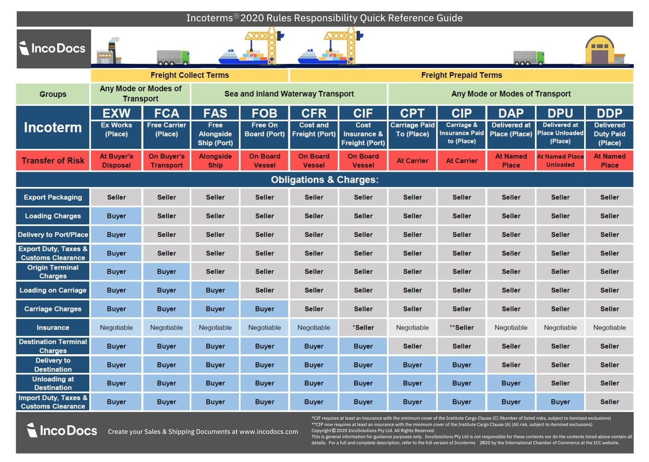
Overview of Incoterms and Discussion
https://incodocs.com/blog/wp-content/uploads/2025/01/Incoterms-latest-updated-chart.jpg

Slide 12
Customs and Regulatory Compliance
Notes:
---
This slide references information from the following file: https://iclgroup365-my.sharepoint.com/personal/bruce_holden_icl-group_com/_layouts/15/Doc.aspx?sourcedoc=%7B1EDCB2E4-37AB-4F58-949A-48E4936CD834%7D&file=paid%20to%20deliver.docx&action=default&mobileredirect=true
A More Detailed Overview of Customs

Slide 13
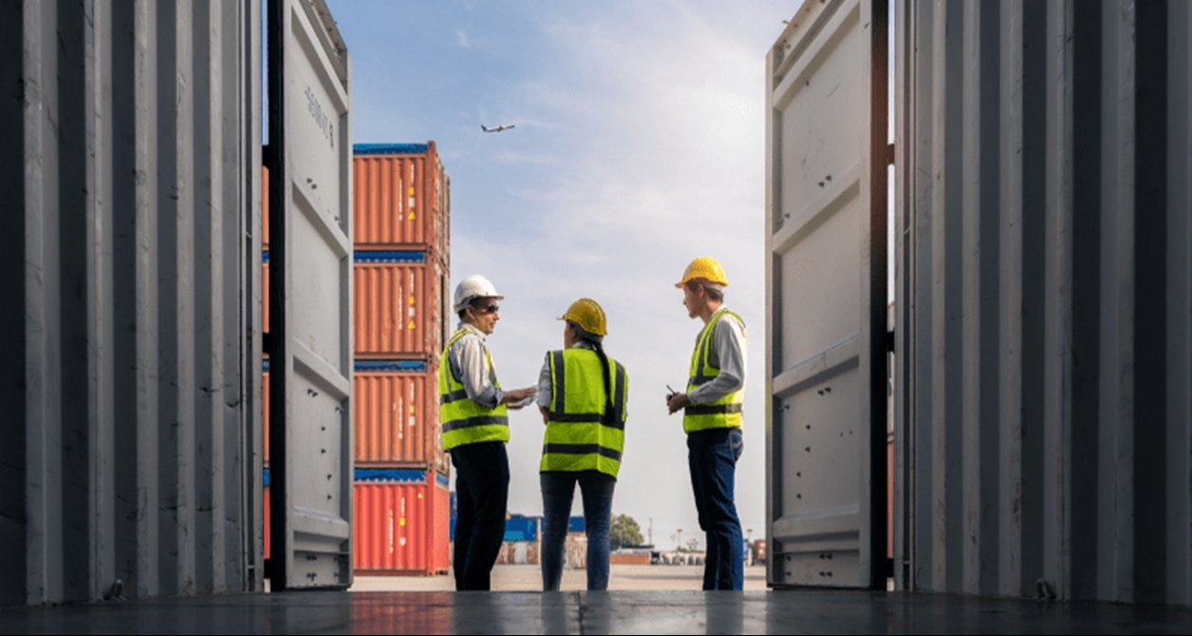
A More Detailed Overview of Customs
https://5.imimg.com/data5/SELLER/Default/2024/8/444416009/BR/RE/PR/226133914/customsclearance.jpg
Complex Regulatory Environment
  Pharma logistics customs involve stringent regulations to ensure drug safety and security compliance worldwide.
Restrictions on Transshipment
  Transshipment limitations in sensitive regions reduce logistics flexibility and require alternative planning.
Handling Dangerous Goods
  Specialized documentation and international safety standards govern the transport of hazardous pharmaceutical products.
Compliance and Collaboration
  Robust compliance programs and technology improve documentation and cooperation with customs authorities.
Notes:
---
This slide references information from the following file: https://iclgroup365-my.sharepoint.com/personal/bruce_holden_icl-group_com/_layouts/15/Doc.aspx?sourcedoc=%7B1EDCB2E4-37AB-4F58-949A-48E4936CD834%7D&file=paid%20to%20deliver.docx&action=default&mobileredirect=true
Customs procedures in pharma logistics are complex due to stringent regulations governing drug safety and security. Transshipment strategies, often used to deliver goods to politically sensitive regions, are becoming increasingly restricted, limiting flexibility. Handling dangerous goods requires compliance with international safety standards and specialized documentation. Dual-use restrictions, which apply to products with both civilian and military applications, add another layer of complexity. Failure to comply can result in severe penalties, shipment delays, and reputational damage. Companies must invest in robust compliance programs, leverage technology for automated documentation, and maintain close collaboration with customs authorities. Proactive planning and continuous monitoring are essential to navigate these challenges effectively.

Slide 14
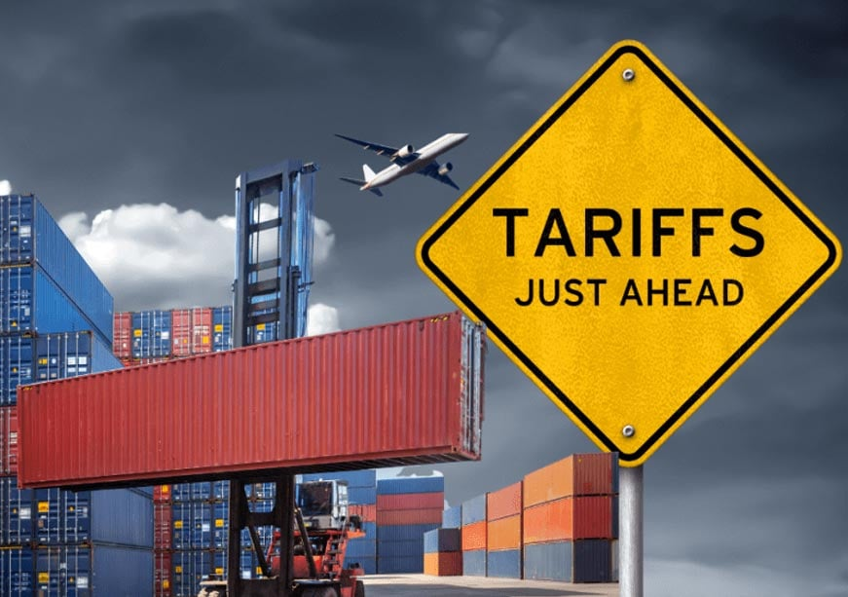
Tariffs
Raw materials / packaging
Just in time – hoarding of goods
Chinese ships – tariffs on hold
Rerouting of supply chain
New relationships – new opportunities?
Unpredictability

Slide 15
Cold Chain Management
Notes:
---
This slide references information from the following file: https://iclgroup365-my.sharepoint.com/personal/bruce_holden_icl-group_com/_layouts/15/Doc.aspx?sourcedoc=%7B1EDCB2E4-37AB-4F58-949A-48E4936CD834%7D&file=paid%20to%20deliver.docx&action=default&mobileredirect=true
Cold Chain Maintenance

Slide 16
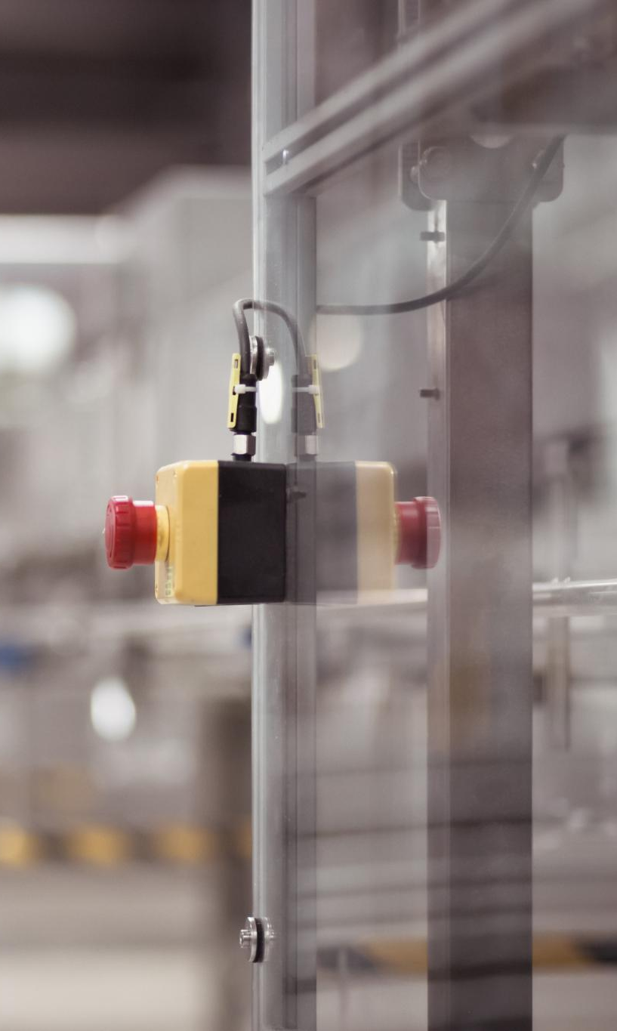
Cold Chain Maintenance
Temperature Control Techniques
  Use dry ice, phase change materials, and thermal blankets to maintain required cold temperatures during pharmaceutical transit.
Challenges in Cold Chain
  Fluctuating ambient temperatures, long transit times, and customs handling risk cold chain integrity and product safety.
Advanced Monitoring Systems
  Sensors/ strips provide real-time temperature monitoring to detect deviations and trigger corrective actions.
Protocols and Training
  Rigorous protocols, trained personnel, and reliable packaging are essential to ensure compliance and product efficacy.
Notes:
---
This slide references information from the following file: https://iclgroup365-my.sharepoint.com/personal/bruce_holden_icl-group_com/_layouts/15/Doc.aspx?sourcedoc=%7B1EDCB2E4-37AB-4F58-949A-48E4936CD834%7D&file=paid%20to%20deliver.docx&action=default&mobileredirect=true
Cold chain logistics ensures temperature-sensitive pharmaceuticals remain within specified ranges throughout transit. Techniques include using dry ice for ultra-low temperatures, phase change materials (PCMs) for controlled thermal environments, and thermal blankets for insulation. Maintaining cold chain integrity is critical to preserving product efficacy and patient safety. Challenges include fluctuating ambient temperatures, long transit times, and handling during customs inspections. Advanced monitoring systems, such as IoT-enabled sensors, provide real-time visibility into temperature conditions, enabling corrective actions when deviations occur. Companies must implement rigorous protocols, train personnel, and invest in reliable packaging solutions to mitigate risks and comply with regulatory standards.

Slide 17

Active or passive control on gross shippers
Active – energy intensive/ can be used for extensive travel
  Costly if there is a breakdown
  Loyal customer base
  Conservative use – truck transport
Passive
  Air freight
  No moving parts
  High level insulation

Slide 18
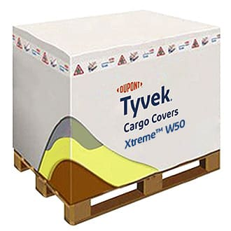
Thermal Blankets
Pallet covers
Reflects solar energy to reduce temperature excursions
Ideally Breathable, waterproof, and weather-resistant
Cost-effective thermal protection for hot and cold conditions – temporary solution

Slide 19
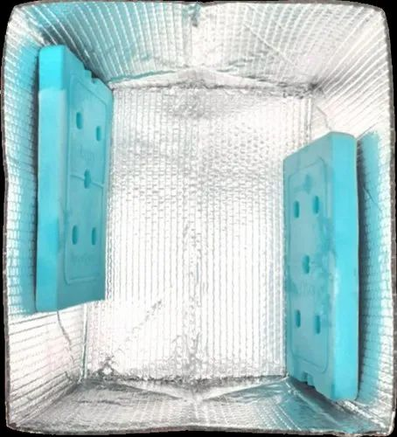
PCMs
Refrigerated, controlled room temperature, and frozen / suppressed temp (dry ice substitute)
5/7/17 – Enshield ® - thermal cover on top
Use in pharma cooling / biological transport or even in first aid as an add on to medical shipments.
Compared to standard gel packs – longer temp regulation
Use in cold conditions- small but growing market.
Cheese and beer!

Slide 20
Monitoring
Strips
  Cheapest option
  Promoted use – final leg transfer for lesser value products
Wireless temperature sensors
  Bluetooth/ cellular
  Continuous monitoring / Real time tracking
  Portable Temperature Loggers
    Short-term shipments or last-mile delivery
    Can be single use or re-usable

Slide 21
Industry Challenges and Sustainability
Notes:
---
This slide references information from the following file: https://iclgroup365-my.sharepoint.com/personal/bruce_holden_icl-group_com/_layouts/15/Doc.aspx?sourcedoc=%7B1EDCB2E4-37AB-4F58-949A-48E4936CD834%7D&file=paid%20to%20deliver.docx&action=default&mobileredirect=true
Challenges to the Industry, Sustainability

Slide 22

Challenges to the Industry
Supply Chain Disruptions
  Tariffs and protectionist policies increase costs and complexity in global pharmaceutical supply chains.
Labour Shortages
  Immigration laws reduce availability of drivers and warehouse staff, worsening labour shortages in pharma logistics.
Adaptive Strategies
  Companies invest in automation, tracking and diversified supply chains.
Building Resilience
  Scenario planning and strategic partnerships help companies prepare for sudden regulatory changes and uncertainties.
Notes:
---
This slide references information from the following file: https://iclgroup365-my.sharepoint.com/personal/bruce_holden_icl-group_com/_layouts/15/Doc.aspx?sourcedoc=%7B1EDCB2E4-37AB-4F58-949A-48E4936CD834%7D&file=paid%20to%20deliver.docx&action=default&mobileredirect=true
The pharma logistics industry faces systemic challenges, including legislative changes, trade wars, and demographic shifts. Tariffs and protectionist policies disrupt global supply chains, increasing costs and complexity. Immigration legislation affects the availability of drivers and warehouse staff, exacerbating labor shortages. These factors demand adaptive strategies, such as diversifying supply routes, investing in automation, and advocating for favorable policies. Companies must also prepare for sudden regulatory changes that can impact operations and profitability. Building resilience through scenario planning and strategic partnerships is essential to navigate these uncertainties.

Slide 23

Sustainability
Eco-Friendly Packaging
  Using recycled materials and eco-friendly alternatives reduces waste and microplastic pollution in pharma logistics packaging.
Emission Reduction Strategies
  Optimizing routing and using energy-efficient vehicles help cut CO2 emissions in the supply chain.
Supply Chain Collaboration
  Collaboration and investment in green technologies are crucial for achieving long-term sustainability goals.
  Reduce, reuse, recycle
  The reuse and proper disposal of products moves the ecosystem
Notes:
---
This slide references information from the following file: https://iclgroup365-my.sharepoint.com/personal/bruce_holden_icl-group_com/_layouts/15/Doc.aspx?sourcedoc=%7B1EDCB2E4-37AB-4F58-949A-48E4936CD834%7D&file=paid%20to%20deliver.docx&action=default&mobileredirect=true
Sustainability is a growing priority in pharma logistics, driven by environmental concerns and regulatory pressures. Initiatives include using recycled plastic skids, reducing microplastic pollution, and adopting eco-friendly alternatives for wrapping and tape. Companies are exploring innovative packaging solutions to minimize waste and improve recyclability. Reducing CO2 emissions through optimized routing, energy-efficient vehicles, and last-mile delivery innovations is critical for meeting sustainability goals. These efforts not only enhance corporate reputation but also reduce operational costs over time. Collaboration across the supply chain and investment in green technologies will be key to achieving long-term sustainability objectives.

Slide 24
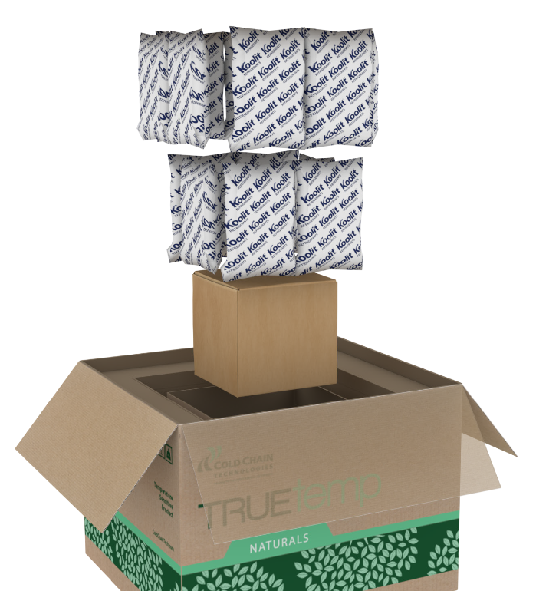
Plastic Everywhere
https://www.coldchaintech.com/hs-fs/hubfs/TRUEtemp_Naturals.png?
Move to curbside recycling
Pallets – paper or plastic?
Wrapping – newer alternatives

Slide 25
Technology Integration
Notes:
---
This slide references information from the following file: https://iclgroup365-my.sharepoint.com/personal/bruce_holden_icl-group_com/_layouts/15/Doc.aspx?sourcedoc=%7B1EDCB2E4-37AB-4F58-949A-48E4936CD834%7D&file=paid%20to%20deliver.docx&action=default&mobileredirect=true
Use of AI, Tracking of Trucks

Slide 26

Use of AI
AI Enhancing Pharma Logistics
  AI facilitates communication, predictive analytics, and automation within pharmaceutical supply chains for improved efficiency.
Improved Decision-Making
  AI platforms provide visibility across supply chains, supporting proactive issue resolution and better decisions.
Balance Between AI and Humans
  While AI enhances logistics, human interaction remains crucial for complex problem-solving and relationship management.
Adapting to Regulatory Changes
  AI assists in learning and adapting to regulatory updates like changes to Incoterms, ensuring compliance.
Notes:
---
This slide references information from the following file: https://iclgroup365-my.sharepoint.com/personal/bruce_holden_icl-group_com/_layouts/15/Doc.aspx?sourcedoc=%7B1EDCB2E4-37AB-4F58-949A-48E4936CD834%7D&file=paid%20to%20deliver.docx&action=default&mobileredirect=true
Artificial Intelligence (AI) is revolutionizing pharma logistics by enabling seamless intercompany communication, predictive analytics, and process automation. AI-driven platforms enhance visibility across the supply chain, allowing for proactive issue resolution and improved decision-making. While digital tools offer significant benefits, human interaction remains essential for resolving complex bottlenecks and maintaining relationships. AI can also assist in learning and adapting to regulatory changes, such as updates to Incoterms. Companies should adopt a balanced approach, leveraging AI for efficiency while preserving the value of personal engagement in critical negotiations and problem-solving.

Slide 27
Example from MS Copilot– “can i use FOB for container shipments?”
Criteria | FOB (Free on Board) | FCA (Free Carrier)
Risk Transfer Point | When goods are loaded on the vessel | When goods are handed to the carrier
Suitability for Containers | Not recommended | Highly recommended
Typical Usage | Bulk cargo, traditional sea freight | Containerized shipments

Slide 28
Copilot: “Choosing Between CPT and CIP incoterms for container shipments”
Factors for Decision Making​
Consider cargo value, risk tolerance, and insurance preferenceswhen choosing CPT or CIP for container shipments.​
CPT Shipping Terms​
CPT suits companies managing their own insurance and shippinggoods with lower risk and value.​
CIP Shipping Terms​
CIP provides insurance arranged by the seller, ideal for high-valueor fragile goods needing extra security.​
Balancing Cost and Risk​
Choosing between CPT and CIP is balancing cost efficiency withrisk management strategies for safer shipments.​

Slide 29
Prompt: “ok, well a little table please between CFR and CIP”
Criteria | CFR (Cost and Freight) | CIP (Carriage and Insurance Paid To)
Risk Transfer Point | When goods are loaded on the vessel | When goods are handed to the carrier
Insurance Requirement | Seller is not required to insure | Seller must provide insurance
Cost Coverage | Seller pays freight to destination port | Seller pays freight and insurance to destination
Typical Usage | Sea freight (bulk or container) | Containerized cargo, multimodal transport

Slide 30
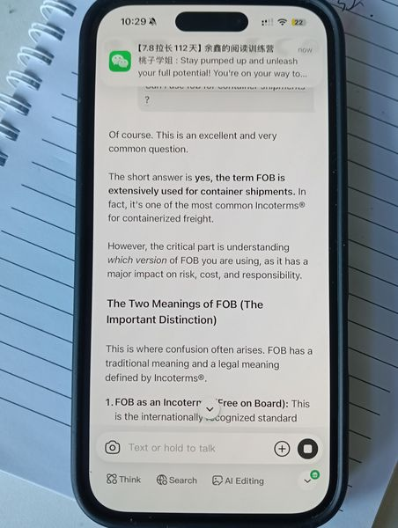
☹ - “can i use FOB for container shipments?” - Deepseek

Slide 31

Tracking of Trucks
Real-Time GPS Tracking
  GPS systems provide live shipment location updates, improving security and preventing delays in pharma logistics.
Security and Cyber Risks
  Tracking data is sensitive and vulnerable to cyber threats, requiring strong cybersecurity for protection.
Regulatory and Operational Challenges
  Immigration regulations impact driver availability and cross-border logistics, increasing planning complexity.
Integrated Secure Solutions
  Combining secure tracking and compliance measures ensures asset safety and smooth logistics operations.
Notes:
---
This slide references information from the following file: https://iclgroup365-my.sharepoint.com/personal/bruce_holden_icl-group_com/_layouts/15/Doc.aspx?sourcedoc=%7B1EDCB2E4-37AB-4F58-949A-48E4936CD834%7D&file=paid%20to%20deliver.docx&action=default&mobileredirect=true
Real-time tracking of trucks enhances security and operational efficiency in pharma logistics. GPS-enabled systems provide visibility into shipment locations, reducing risks associated with theft and delays. However, tracking introduces security concerns, as sensitive data could be exploited by malicious actors. High-value pharmaceutical cargo requires robust cybersecurity measures to protect tracking systems. Additionally, immigration regulations can affect driver availability and cross-border movements, adding complexity to logistics planning. Implementing secure, integrated tracking solutions is essential for safeguarding assets and ensuring compliance.

Slide 32
Future Outlook
Notes:
---
This slide references information from the following file: https://iclgroup365-my.sharepoint.com/personal/bruce_holden_icl-group_com/_layouts/15/Doc.aspx?sourcedoc=%7B1EDCB2E4-37AB-4F58-949A-48E4936CD834%7D&file=paid%20to%20deliver.docx&action=default&mobileredirect=true
The Future

Slide 33
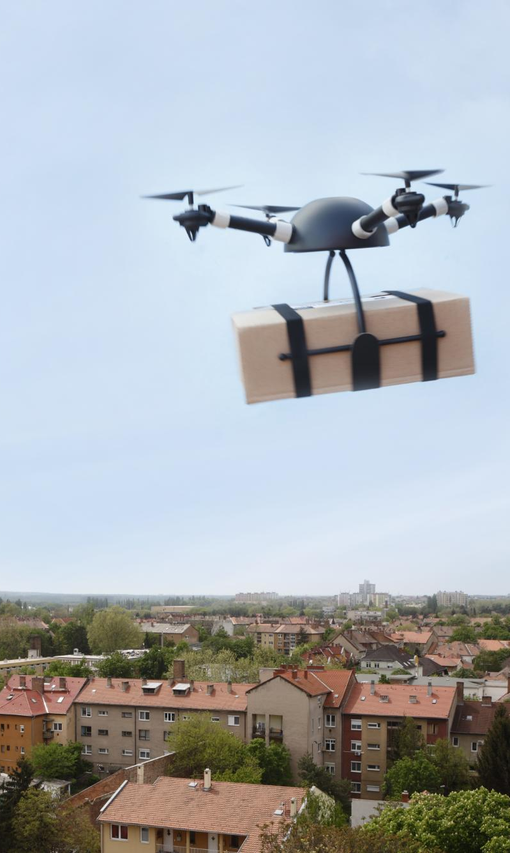
The Future
Innovations in Last-Mile Delivery
  Creative solutions like remote deliveries and decentralized hubs address rural last-mile distribution challenges. Local centres becoming collection points.
Sustainable Packaging Advances
  Adoption of recyclable, eco-friendly materials including phase change materials ensures temperature control and environmental compliance.
Regulatory and Environmental Compliance
  Pharma companies must prepare for evolving refuse requirements while minimizing environmental impact.
Digital Technologies and Collaboration
  Embracing digital tools and fostering collaboration are critical to building resilient, future-ready supply chains.
Notes:
---
This slide references information from the following file: https://iclgroup365-my.sharepoint.com/personal/bruce_holden_icl-group_com/_layouts/15/Doc.aspx?sourcedoc=%7B1EDCB2E4-37AB-4F58-949A-48E4936CD834%7D&file=paid%20to%20deliver.docx&action=default&mobileredirect=true
The future of pharma logistics will be shaped by innovations in last-mile delivery, sustainability, and packaging. Rural areas present unique challenges for last-mile distribution, requiring creative solutions such as drone deliveries or decentralized hubs. Regulatory pressures will drive the adoption of recyclable packaging and eco-friendly materials, including phase change materials (PCMs) for temperature control. Companies must also prepare for evolving refuse requirements, ensuring compliance while minimizing environmental impact. Embracing digital technologies, fostering collaboration, and prioritizing sustainability will be critical for building resilient, future-ready supply chains.

Slide 34

The Future Freaks Me Out
Finance – SOX and transport charging
Job hugging / multi disciplinary teams?
Centralized hubs
        Direct to patient
Localized final production
        Bioreactors – regulatory issues?
        Final formulation
All eggs in 1 basket or more efficient solution
        Performance based contracts

Slide 35
Thank you
Notes:
---
This slide references information from the following file: https://iclgroup365-my.sharepoint.com/personal/bruce_holden_icl-group_com/_layouts/15/Doc.aspx?sourcedoc=%7B1EDCB2E4-37AB-4F58-949A-48E4936CD834%7D&file=paid%20to%20deliver.docx&action=default&mobileredirect=true
The Future

