Slide 1


Using AI to
Enable Dynamic Master Data in ERP Systems
Transforming static records into agile, actionable insights.
Achint Bhatnagar

Slide 2



Achint Bhatnagar
21 years working on enterprise systems and processes.
12 years in life sciences.
Start up, Scale up, Early and Late discovery, Clinical and Commercial supply chains.
Industries:
Aero & Defence, CPG, Hi Tech, Manufacturing
Biotech, Cell Therapy, Medical Electronics (Devices), Pharma (Small Molecule).

Slide 3

Agenda
Challenges
Agility: The Game Changer
Improvements
Use Cases
Notes:
The Foundational Challenge
The Impact on Agility
AI Solution(s) for Master Data Agility
Intelligent Data Ingestion & Cleansing
Continuous Enrichment and Predictive Insights
Accelerating Supply Chain Agility
Use Case : Medical Device Manufacturer, API manufacturer, Cell Therapy Manufacturer

Slide 4

Challenges
Static master data = outdated, siloed, rigid
Rapid change, unclear dependencies
Variable output, unpredictable demand
Notes:
It becomes outdated (incorrect), leads to data silos, and creates a rigid (manual) supply chain.
Start ups / Scale ups (New company / site) have too much changing MD.
Business where dependencies are unclear.
API manufacturing (Small molecule / Biologics) – how much of raw materials will produce how much output. What parameters will control enhance production.
Media Manufacturing – How much of the raw materials will produce how much output. (Antibodies / cells) etc.
Independent Demand and rapidly changing demand.

Slide 5

Slow Decision-Making
Operational Inefficiencies
Poor Visibility
Inability to Scale
Financial loss
Notes:
Slow Decision-Making: Decisions are based on old, incomplete data.
Operational Inefficiencies: Errors and inconsistent formats lead to costly mistakes.
Poor Visibility: Difficulty in seeing the full, end-to-end supply chain.
Inability to Scale: Manual processes can't keep up with growth.
Financial loss: Expired material to be scrapped.
References:
Target Canada: A key factor in Target's multi billion-dollar failure ($5.4 billion loss) in Canada was a disastrous supply chain and inventory system.
Nike's Forecasting Failure: In the early 2000s, Nike lost an estimated $100 million due to a faulty inventory management system that overestimated demand for some products while underestimating others.
JP Morgan Chase: Even in the financial sector, inventory-related errors can be costly. A famous example involved the loss of nearly $6 billion in 2012 due to faulty formulas and copy-and-paste errors in Excel spreadsheets used for tracking inventory and risk.

Slide 6

Agility: The Game Changer
AI: Making Data Dynamic

Slide 7
What does Agility Mean
Living, learning master data
Automated cleansing & governance
Self-correcting foundation
Notes:
AI to transforms master data from a static record to a living asset.
AI automates the entire data lifecycle, from cleansing to governance.
This creates a self-correcting, continuously learning data foundation.

Slide 8

Improvements - Data Cleansing
Deduplicate
Standardize
Enrich
Predict
Notes:
Intelligent Data Ingestion & Cleansing:
Smart Deduplication: Identify clean near duplicate records.
Data Standardization: Normalize data to ensure consistency.
Continuous Enrichment and Predictive Insights
Automated Enrichment: AI fills in missing data fields by pulling from internal and external sources
Predictive Analytics: Analyzes historical and real-time data to forecast changes.

Slide 9

Improvements
Quality
Real-time checks
Fewer errors
Risk mitigation
Notes:
Enhanced Data Quality and Accuracy
Real-time Validation: AI continuously monitors data and flags issues instantly
Reduced Human Error: Automation minimizes manual data entry.
Accelerating Supply Chain Agility
Faster Time-to-Market: AI accelerates product launches with rapid data validation.
Optimized Operations: Enable smarter decisions in areas like inventory and logistics.
Proactive Risk Mitigation: Businesses can anticipate and respond to disruptions.

Slide 10
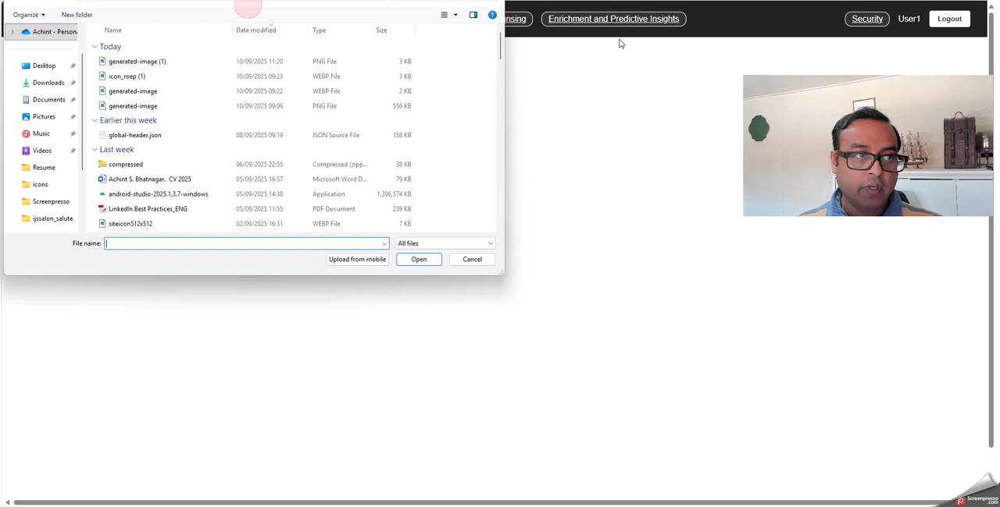

Slide 11

Use Cases

Slide 12
Reducing Purchasing Errors and Wastage Through Automated Master Data Correction
Problem Statement
  Rapid changes in the supply chain. Closing multiple plants, changing distribution setups.
  Master Data across your systems is currently incorrect and incomplete.
Impact
  Incorrect purchases. (Wrong Quantities, Wrong Items)
  Too little shelf life for the quantities available. (Expiration)
  Manual checking (Resource Impact). No trust on systems. (Change Management)
Solution
  Use AI based MD tools to update the MD every day / week / month.
  Tool identifies and flags inconsistencies in the data.
  Tool help with scale up scenarios. With both dependent and independent demands.
  Update incomplete data based on Supply Chain principals / guidelines for different parameters.

Slide 13
API Manufacturer (Small molecule or biologics)
Problem Statement
  Chemical reaction (small molecule) or biological reaction (biologics) and how much of the antibody will be produced is not an exact science in the real-world applications.
  Based on different temperature and pressure conditions and many other parameters, efficiency of reaction changes.
  Output can never be guaranteed based on previous batches. Each batch is different and to a certain extend “uncontrolled”.
Impact
  Volumes being produced can be estimated but not confirmed.
  Raw materials used can also not be exact.
Solution
  Give the data from historian, data lake etc to the AI tool.
  Have the tool analyze existing data. Storing the batch parameters is a GMP requirement.
  Let the AI tool control process order range of quantities of raw materials / output. (ICH Topic Q7 GMP for API) (CPMP/ICH/4106/00).

Slide 14
Cell Therapy Manufacturer (Media manufacturing)
Problem Statement
  How much media should be provided to produce the max cells fastest.
  What parameters, guidelines will decide when, what and how much media should be provided.
  In case the cells stop growing, do we stop or continue or change something to reduce “out of spec” situations.
Impact
  Batches get rejected or have deviations.
  Patient care deteriorates.
Solution
  Give the data from historian, data lake etc to the AI tool.
  Have the tool analyze existing data. Storing the batch parameters is a GMP requirement.
  Let the AI tool control process order range of quantities of raw materials / output. (ICH Topic Q7 GMP for API) (CPMP/ICH/4106/00).

Slide 15
Thank you!
Questions?

